Slide 1
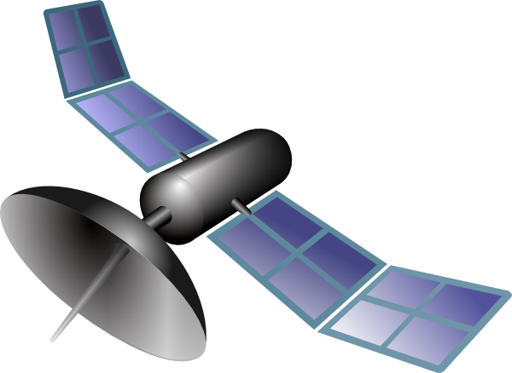

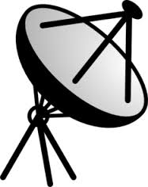

Slide 2
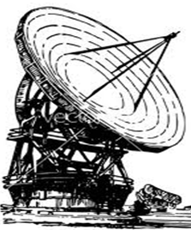

Slide 4
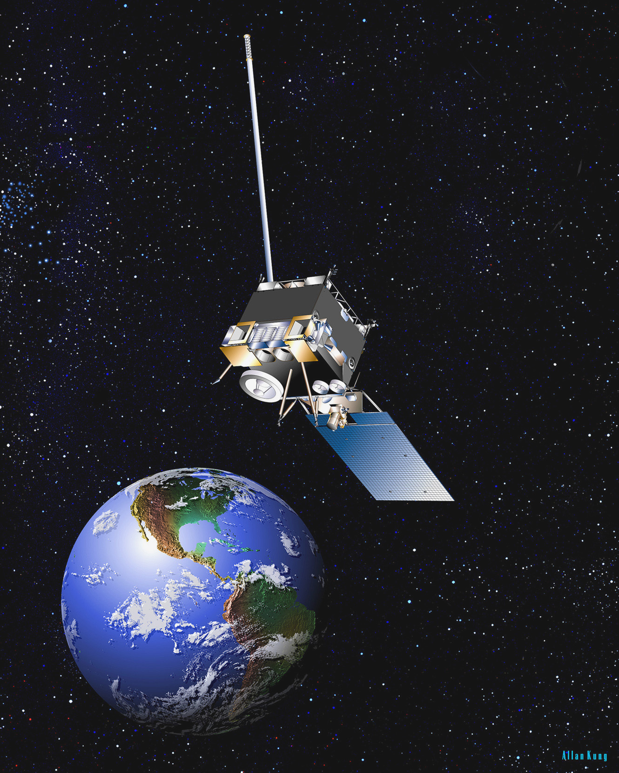
Abdullah Saad Ahmed Alqahtani (202322135)
VSAT

Slide 5
Agenda
Introduction
What is a VSAT?
Components of VSAT
Uplink & Downlink
Satellites used in the VSAT system
Advantages and Disadvantages
VSAT Network Topologies
Example for using VSAT in KSA
Summary
References

Slide 6
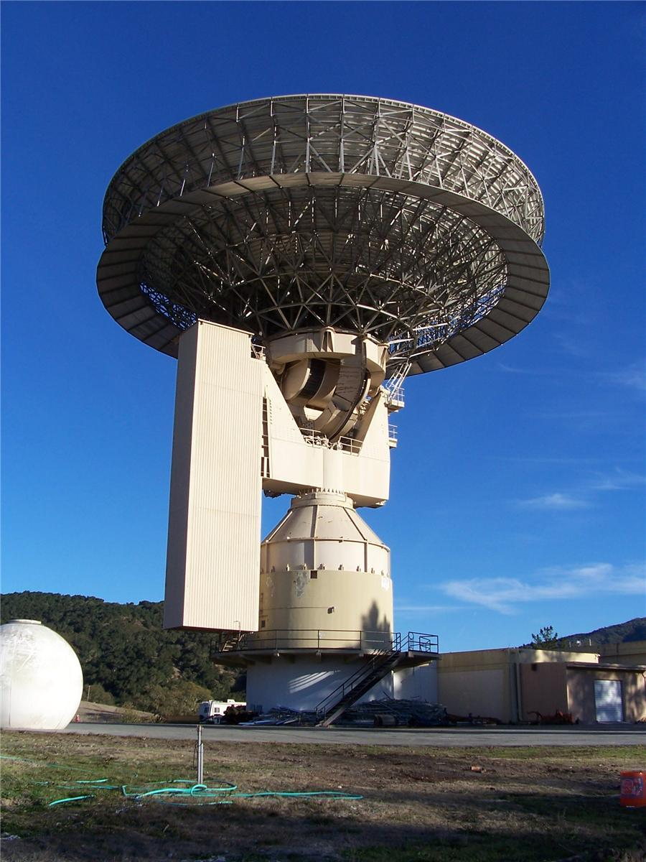
Introduction
The old earth stations and antennas were large sizes.
The Satellite was suffering from weak transmission and the impact of higher noise on the ground stations.
So the receiving stations must be large size and complex installation.
These satellites have developed
and become a high transmitter.
So the ground stations changed
to small size Stations with less
expensive and less complex and
called VSAT.

Slide 7
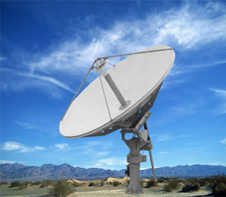
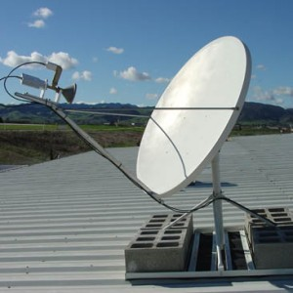
What is a VSAT?
A very small aperture terminal (VSAT) is a small telecommunication earth station that receives and transmits data, video or voice via satellite.
The "very small" component of the VSAT acronym refers to the size of the VSAT dish antenna-typically about 60 cm to 3.8 m.

Slide 8
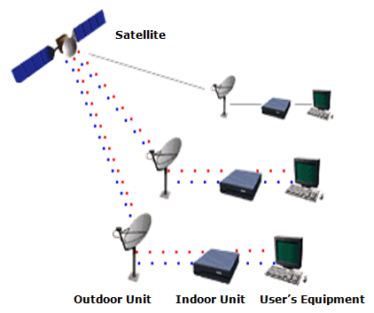
Components of VSAT
It has two basic components:
Ground Segment (earth segment), which is divided into:
  - Outdoor Unit (ODU), which contains the antenna.
  Indoor Unit (IDU), which contains the interface between the VSAT and the customer’s
  Equipment (PCs, TVs,
  Telephones).
Space Segment namely
  satellite.

Slide 9


Slide 10
Uplink & Downlink
VSAT uses different frequencies:
  Ku-band frequency: is usually used in North America and Europe by using small VSAT antenna with uplink frequency about 18 GHz and downlink around 12 GHz.
  C-band frequency: is usually used in Asia, Africa and South America and operating with much larger antenna, with uplink frequency around 6 GHz as for downlink frequency around 4 GHz.
  The new Ka-band frequency: is typically in the downlink frequencies up to 22 GHz and uplink frequencies up to 31 GHz.

Slide 11
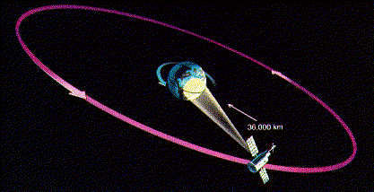
The satellites that are used in the VSAT system?
VSAT system used geostationary earth orbit (GEO) satellites that revolve around the equator at the same rotational speed as the earth.
Appearing as though they are not moving at all, GEOs are always in the same place above the earth. They also cover a large geographic area.
Direction from earth:
36,000 km (22,282 miles).
Speed: 11,300 Km/h.

Slide 12
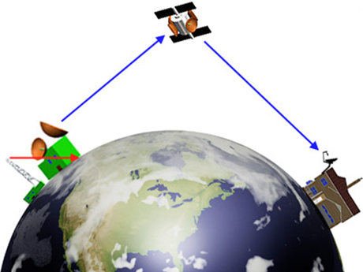
VSAT Advantages:
High flexibility to increase the size of the network in the future.
Able to integrate large number of the networks.
Cover distant geographical locations.
Ability to handle Voice, Video and Data.
VSAT Disadvantages:
Requires clear line of sight between dish and satellite.
Outages in some cases, because of the weather. These outages normally last for a few minutes.

Slide 13

Group work
7min

Slide 14
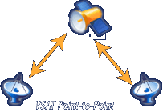
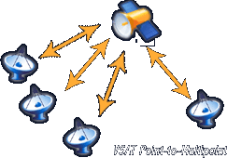
VSAT Network Topologies
The connection between Terminal and Terminal called (Point to Point).
The connection between Hub and Terminals called (Point to Multipoint).
The most important types of link are:
  Star Topology.
  Mesh Topology.

Slide 15
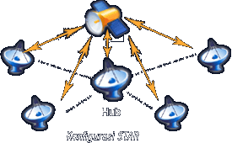
Star Topology
VSAT terminals cannot communicate directly with each other, they have to go through the hub.
It is commonly used for internet connection purpose.
Smaller VSAT antenna sizes (1.8 m typically).
The performance of the network is directly dependent on the performance of the hub.

Slide 16
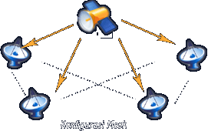
Mesh Topology
This network enables direct communication from one point to another.
Its usually found in telephone and data lines.
larger VSAT antenna sizes (3.8 m typically).
If one of the components fails there is another line.

Slide 17

Example for using VSAT in KSA
Saudi Post Electronic Network.
To connect 1230 post offices.
During 2005, 37 postal sites were connected to the network in order to use some of the postal applications.

Slide 18

7min

Slide 19
Summary
VSAT is a perfect solution in answering voice, data and video, especially in the absence of terrestrial transmission coverage.
Utilizing VSAT offers maximum benefit, which enables company to expand very fast without affected by lack of local telecommunication network infrastructure.
VSAT is available anywhere in the Kingdom with the ability to connect remote areas.

Slide 20
References
http://www.techopedia.com/definition/5095/very-small-aperture-terminal-vsat
http://www.satkomindo.com/vsat.html
http://www.networkmagazineindia.com/200206/case1.shtml

Slide 21
Thank you
for your attention

