Slide 1
Satellite – Block Diagram
Tejus S
-Technical Sales Associate

Slide 2
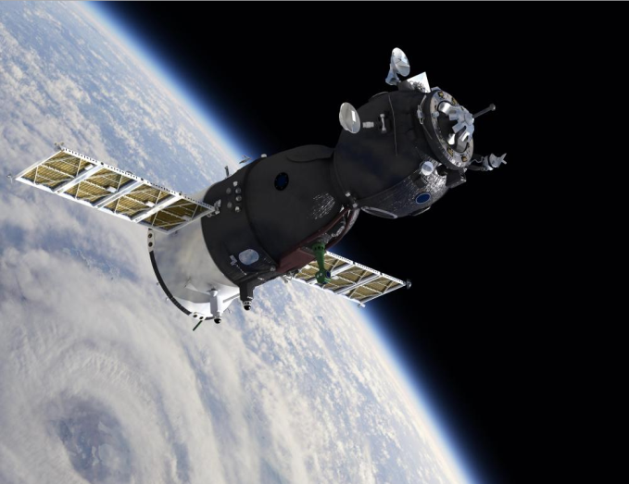
Agenda
General Satellite Block diagram
Subsystem analysis
  ADCS
  Command and Data Handling system
  Electrical Power System
  Communication System
  Payloads
    Transponder
    Lunar Ranging Instrument
    X-Ray and Gamma Ray Spectroscopy
    CALIOP(LIDAR)
    Synthetic Aperture RADAR

Slide 3
Block Diagram
ELECTRICAL POWER SYSTEM
Solar Panels
Batteries
DC/DC Converters
Power Distribution
ATTITUDE DETERMINATION AND CONTROL SYSTEM
Earth/Sun/Star Sensor
Magnetometer
Gyroscopes
GPS
To all Units
SOLID STATE MEMORY
ACTUATOR ELECTRONICS
PWM Controllers
DACs
ON BOARD COMPUTER & DATA HANDLING
PAYLOADS
Communication
Lunar Ranging Instrument
CALIOP
SAR
PAYLOAD INTERFACE
PROPULSION SYSTEM
COMMUNICATION SYSTEM
GROUND STATION
Notes:
Block Diagram of a Satellite
Attitude Determination and Control System- Determines the attitude of the satellite and orientation of the satellite is done accordingly.
On Board Computer and Data Handling – The On Board Computer is responsible for taking all the major decisions on the satellite.
Communication System – For communicating with the Ground Station
Payloads – Different Payload on the satellite perform definite functions.
Electrical Power Systems – Distribution of required power for each subsystem.

Slide 4
Attitude Determination & Control System
It’s all about orientation!!
The ADCS stabilizes the spacecraft and orients it in desired directions during the mission despite the external disturbance torques acting on it.
Consists of Two parts- The Attitude Determination & The Attitude Control system.
Attitude determination is the process of determining the orientation and location of the spacecraft relative to some reference frame such as-unit vectors directed toward the Sun, the center of the Earth, a known star, or the magnetic field of the Earth.
Determination is done with the help of array of sensors such as sun sensors, star trackers, horizon sensors, accelerometers, magnetometers, gyroscopes and GPS.
The process of achieving and maintaining an orientation in space is called attitude control.
Attitude Control is obtained by collecting data from all the sensors and processing it accordingly and based upon it causing actuation for orbit/path correction.

Slide 5
Attitude Determination & Control System
Sun Sensor
LVDS
FPGA
Star Sensor
LVDS
Actuator Electronics
Horizon Sensor
LVDS
Accelerometer
LVDS
Magneto meter
Actuator s
LVDS
Gyro Sensor
LVDS
GPS
LVDS
Back to Main
Notes:
Attitude Determination and Control System. Data is taken from all the Sensors and the orientation of the Satellite is done accordingly.

Slide 6
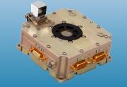
Sun Sensor
It is a device that senses the direction to the Sun. They are also used to position solar arrays.
Sun sensors are basically required in spacecraft operations since most missions require solar power and have sun-sensitive equipment which needs protection against sunlight.
Goes in all satellites.
4-14 Sun sensors per satellite depending on the requirement.

Slide 7
Sun Sensor
CCD/APS
LMP2012QML
Op- Amp for I-V Conversion
LMP2012QML
Amplifier and Low Pass Filter
MUX
ADC128S102QML
12-Bit, up to
200kSPS
SN55LVDS31-SP
DS90LV031AQML
DS90C031QML
LVDS Driver
FPGA
To ADCS FPGA
Clocking Components
CDCM7005-SP
Clock Synchronizer & Jitter Cleaner
ADC Clock
FPGA Clock
To FPGA
TPS50601-SP
DC-DC
Point-Of-Load
Controller
TPS7H1101-SP
Low Dropout
Regulator
V_{DO} =200mV
Power
To
Multiple
Devices
Back to ADCS
Back to Main
Notes:
Sun Sensor – Orientation of the satellite with respect to the sun.
Output of the CCD/APS is about 50Hz (Max).
The charge output is converted into Voltage. LMP2012 precision Op-Amp converts the charge/Current into voltage. This signal is passed through an amplifier and a low pass filter with cut off frequency of about 50Hz.
Several such sections are muxed into the ADC. ADC128S102QML samples these signals at about 50kSPS. The output is taken by the FPGA and sends it to the ADCS FPGA using LVDS interface.

Slide 8
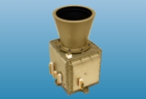
Star Sensor
Star sensors measure the star coordinates in the spacecraft frame and provide attitude information when these observed coordinates are compared with known star directions obtained from star catalog.
Goes in all satellites.
2- 4 Star Sensors will usually be required on each satellite.

Slide 9
Star Sensor
CCD
LMP2012QML
Pre-Amplifier
LMP2012QML
PGA/Amplifier
ADC128S102QML
12-Bit, up to
200kSPS
SN55LVDS31-SP
DS90LV031AQML
DS90C031QML
LVDS Driver
FPGA
To ADCS FPGA
Image Processing Module & Lookup Table
Clocking Components
CDCM7005-SP
Clock Synchronizer & Jitter Cleaner
ADC Clock
FPGA Clock
To FPGA
TPS50601-SP
DC-DC
Point-Of-Load
Controller
TPS7H1101-SP
Low Dropout
Regulator
V_{DO} =200mV
Power
To
Multiple
Devices
Back to ADCS
Back to Main
Notes:
Star Sensor- Orientation of the Satellite with respect to positions of various stars.
The Operation of the star sensor is similar to that of a sun sensor. The Data from the ADC is compared with a Image Processing Module and Lookup Table. The processed signal is then sent to the ADCS FPGA using LVDS interface.

Slide 10
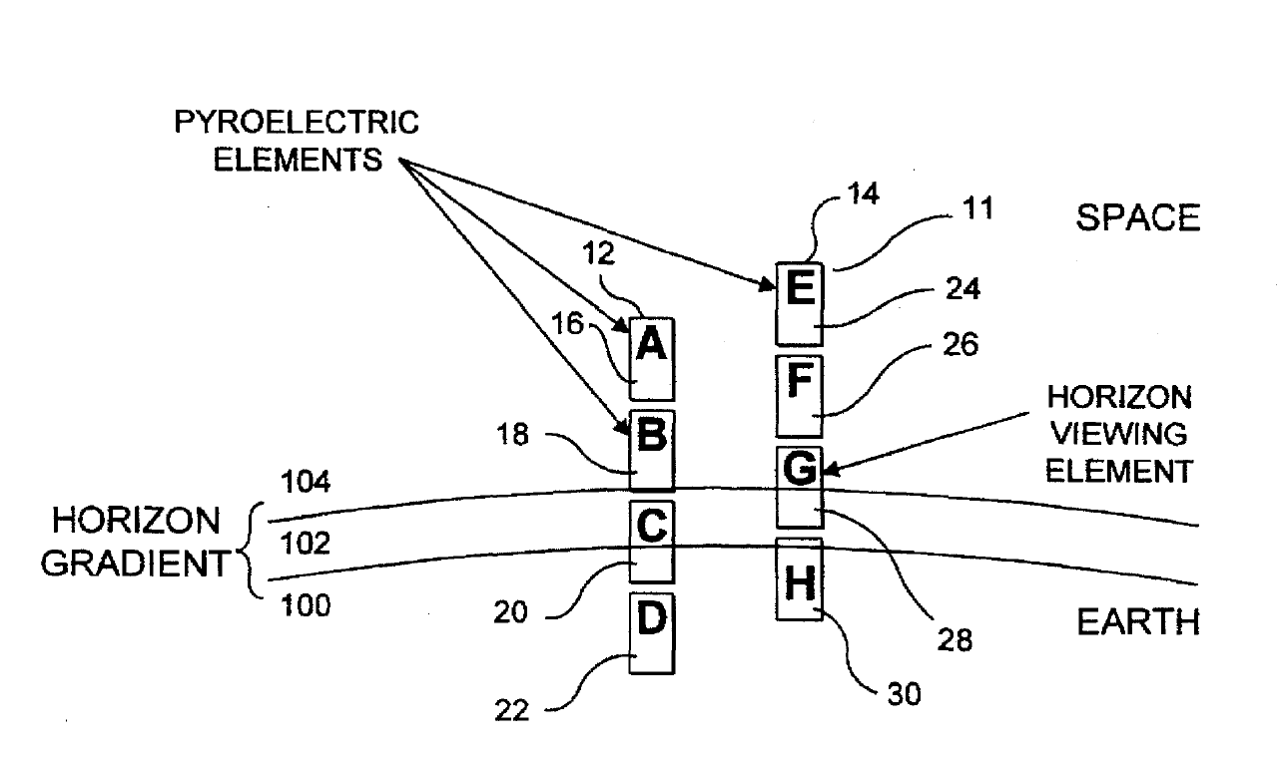
Horizon Sensor
Horizon sensors use the Earth’s horizon to determine the orientation of the spacecraft with respect to Earth. They are infrared devices that detect a temperature contrast between deep space and the Earth’s atmosphere.
The structure consists of an array of sensors as shown in the figure.
Goes into GEO satellites.
2-4 Horizon sensors per satellite.

Slide 11
Horizon Sensor
Lens
Sensor
Array
LMP2012QML
Low Noise Amplifier
Noise: 35nV/√Hz
MUX
LM98640QML
14-Bit, up to
40MSPS
SN55LVDS31-SP
DS90LV031AQML
DS90C031QML
LVDS Driver
FPGA
To ADCS FPGA
Clocking Components
CDCM7005-SP
Clock Synchronizer & Jitter Cleaner
ADC Clock
FPGA Clock
To FPGA
TPS50601-SP
DC-DC
Point-Of-Load
Controller
TPS7H1101-SP
Low Dropout
Regulator
V_{DO} =200mV
Power
To
Multiple
Devices
Back to ADCS
Back to Main
Notes:
Horizon Sensor – Also known as the Earth Sensor is responsible for the orientation of the satellite with respect to the earth or the horizon.
A Sensor array is positioned such that IR rays from both earth, earth’s atmosphere and the space can be detected. This is passed through a section of Low-Noise amplifier. The sampling rate required for this signal is about 5-10MSPS. Also, LM98640QML has inbuilt CCD processing module and PGA which can be used to get the amplification required. The sampled data is sent to the ADCS FPGA through the LVDS interface.

Slide 12

Gyro Sensor
Gyro Rate sensors determine the attitude by measuring the rate of rotation of the spacecraft.
They are located internal to the spacecraft and work at all points in an orbit. Since they measure a change instead of absolute attitude, gyroscopes must be used along with other attitude hardware to obtain full measurements.
Minimum 3 Gyro sensors are used in a satellite.

Slide 13
Gyro Sensor
Rate Sensor
LMP2012QML
Low Noise Amplifier
Demodulator
(Optional)
LMP2012QML
Low Pass Filter and Amp(O)
MUX
ADC128S102QML
12-Bit, up to
200kSPS
SN55LVDS31-SP
DS90LV031AQML
DS90C031QML
LVDS Driver
FPGA
To ADCS FPGA
Clocking Components
CDCM7005-SP
Clock Synchronizer & Jitter Cleaner
ADC Clock
FPGA Clock
To FPGA
TPS50601-SP
DC-DC
Point-Of-Load
Controller
TPS7H1101-SP
Low Dropout
Regulator
V_{DO} =200mV
Power
To
Multiple
Devices
Back to ADCS
Back to Main
Notes:
Gyro Rate sensors determine the attitude by measuring the rate of rotation of the spacecraft.
The choice of the Rate sensor is important for a Gyro Sensor. Some Rate sensors give an Amplitude Modulated output. For such sensors a demodulator section is required. If the Sensor is giving a direct output, then the signal can be directly sent to the ADC after the Low Noise amplification stage.

Slide 14
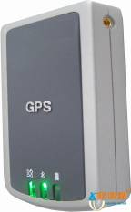
GPS Receiver
The Global Positioning System (GPS) is a space-based satellite navigation system. The addition of a GPS receiver to a spacecraft allows precise orbit determination without ground tracking. It can also be used as a Payload as GPS satellites.
Depending on the requirements, 2 to 4 GPS receivers are used in a satellite.

Slide 15
GPS Receiver
LMH6702QML
Low Noise Amplifier
RF Downconverter
THS4511-SP
LMH6702QML
Amplifier
ADC12D1600QML
ADC10D1000QML
ADS5400-SP
A-D Converter
RF Antenna
SN55LVDS31-SP
DS90LV031AQML
DS90C031QML
LVDS Driver
FPGA
To ADCS FPGA
Clocking Components
CDCM7005-SP
Clock Synchronizer & Jitter Cleaner
ADC Clock
FPGA Clock
To FPGA
TPS50601-SP
DC-DC
Point-Of-Load
Controller
TPS7H1101-SP
Low Dropout
Regulator
V_{DO} =200mV
Power
To
Multiple
Devices
Back to ADCS
Back to Main
Notes:
The addition of a GPS receiver to a spacecraft allows precise orbit determination without ground tracking.
The frequency of the received signal for GPS is variable. Typically it is about 1GHz. The received signal is passed through a LNA. RF down conversion is done to get the signal at the IF. This can be directly sampled using the High Speed ADCs. The choice of the ADCs is dependant on the IF range and also the Band of frequencies that is being received.

Slide 16
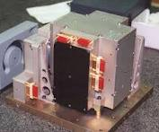
Accelerometer
Accelerometer is one of the most common inertial sensors. Accelerometers are available that can measure acceleration in one, two, or three orthogonal axes and are MEMS(Micro-Electro-Mechanical Sensors).
Works on the F=MA principle.
3 to 4 Accelerometers in a Satellite.

Slide 17
Accelerometer
Capacitive Sensor (One for each Axis)
MUX
LMP2012QML
C-V Conversion
LMP2012QML
Amplifier and Low Pass Filter(500Hz)
ADC
16-Bit, up to
2MSPS
SN55LVDS31-SP
DS90LV031AQML
DS90C031QML
LVDS Driver
FPGA
To ADCS FPGA
Clocking Components
CDCM7005-SP
Clock Synchronizer & Jitter Cleaner
ADC Clock
FPGA Clock
To FPGA
TPS50601-SP
DC-DC
Point-Of-Load
Controller
TPS7H1101-SP
Low Dropout
Regulator
V_{DO} =200mV
Power
To
Multiple
Devices
Back to ADCS
Back to Main
Notes:
Accelerometer is one of the most commonly used inertial sensors.
A capacitive sensor is used, one for each axis. C-V conversion is done and passed through a LPF with a cut off frequency of 500Hz. The ADC for this system typically should have a resolution of 16- bits, should take bipolar inputs and should be sampled at 2MSPS. AD1671 from Analog Devices is currently being used in the Accelerometers and Magnetometers.

Slide 18
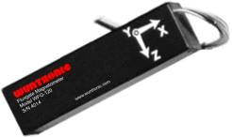
Magnetometer
Magnetometers are vector sensors which measure the strength and direction of then Earth's magnetic field to determine the orientation of a spacecraft with respect to the local magnetic field.
Used in LEO satellites.
2-4 Magnetometers are used depending on the requirements.

Slide 19
Magnetometer
Flux Gate Sensor
MUX
LMP2012QML
Amplifier
ADC
16-Bit, up to
2MSPS
SN55LVDS31-SP
DS90LV031AQML
DS90C031QML
LVDS Driver
FPGA
To ADCS FPGA
Clocking Components
CDCM7005-SP
Clock Synchronizer & Jitter Cleaner
ADC Clock
FPGA Clock
To FPGA
TPS50601-SP
DC-DC
Point-Of-Load
Controller
TPS7H1101-SP
Low Dropout
Regulator
V_{DO} =200mV
Power
To
Multiple
Devices
Back to ADCS
Back to Main
Notes:
Magnetometers are vector sensors which measure the strength and direction of then Earth's magnetic field to determine the orientation of a spacecraft with respect to the local magnetic field.
Output of the Flux gate sensor is passed through an amplifier section. This signal is converted into the Digital domain and sent to the FPGA. Required data formatting is done in the FPGA and is sent to the ADCS FPGA using the LVDS interface.
ADC for this system requires a resolution of 16 bits, bipolar input and a sampling frequency of 2MSPS. AD1671 is the competition.

Slide 20
Electrical Power System
The objective of the electrical power subsystem (EPS) of the Satellite will be to receive, store, and distribute the power required by the satellite.
Power generation is done by means of a solar cell and energy is stored in the batteries.
Power supply voltage level is regulated for different parts of the satellite using dc-dc converters and LDOs and the distribution is done via voltage buses.
Also, power topologies can be locally provided for each board if required (Point of Load).
During an eclipse the energy to the satellite is supplied by the stored battery energy.
Battery charge management is usually implemented using the FPGA. However, comparators can be pitched in for this application.

Slide 21
Electrical Power System
Power Bus
UC1825-SP
DC-DC
Controller
UC1825-SP
DC-DC
Controller
12V @ 10A
For all other electronics on board
5V @ 10A
TPS50601-SP
DC-DC
Point-Of-Load
Converter
LM117HVQML
3- Terminal Adjustable Regulator
TPS7H1101-SP
Low Dropout Regulator
V_{DO} =200mV
3.3V @ 6A
For Digital Circuits
3.3V @ 1.5A
For Analog Circuits
LM117HVQML
3- Terminal Adjustable Regulator
TPS7H1101-SP
Low Dropout Regulator
V_{DO} =200mV
1.8V @ 0.5A
For Digital Circuits
Back to Main
Notes:
This is the general Electrical Power System for the satellite.
The Power from the main bus is stepped to down to required voltages and currents as shown.

Slide 22
Command and Data Handling System
It is the “Brain” of the Satellite.
The Onboard computer is the subsystem controlling all the functions of a satellite and can be regarded as the brain of the satellite.
It will have an operating system installed that will manage the various programs.
The subsystem also reads the data coming in from the various sensors and takes actions accordingly.
The primary requirement of the subsystem is to communicate with the other subsystems on board to keep a track on the process going on in the satellite.

Slide 23
Command & Data Handling System
EEPROM
SMV512K32-SP
SRAM
House Keeping ADC from All subsystems
Memory Bus
Watchdog Timer
SMJ320C6701-SP
SM320C6727B-SP
DSP
Non-Reliable functions
Real Time Clock
FPGA
(Main Control Unit)
SN55LVDS31/2-SP
DS90LV031/2AQML
DS90C031/2QML
LVDS Interface
SN55LVDS31/32-SP
DS90LV031/2AQML
DS90C031/2QML
LVDS Interface
Payloads
To all other devices
TLK2711-SP
1.6 – 2.5 Gbps
SerDes
Transceiver
All Subsystems
CDCM7005-SP
Clock Synchronizer & Jitter Cleaner
To and From other FPGAs
Back to Main
Notes:
This is the Most important part of a satellite. The On-Board Computer and Data Handling systems collects the data from all the subsystems, processes these data and takes the required action accordingly.

Slide 24
Payloads
Transponder
Lunar Ranging Instrument (Chandrayan- I)
CALIOP
X-Ray & Gamma Ray Spectroscpoy
Synthetic Aperture RADAR
Back to Main

Slide 25
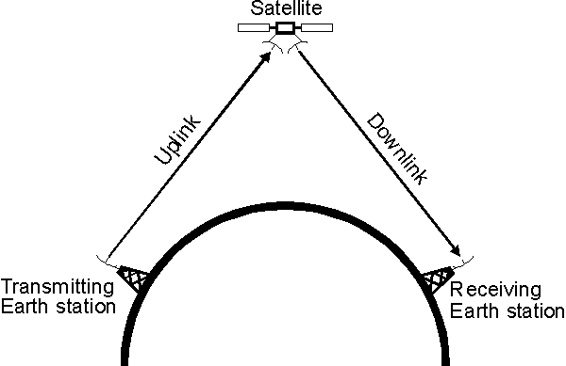
Transponder
In a communications satellite, a transponder gathers signals over a range of uplink frequencies and re-transmits them on a different set of downlink frequencies to receivers on Earth, often without changing the content of the received signal or signals.
This payload will be on all communication satellites.
2-26 transponders (12 & 24 being the most common numbers) operating in the C, Extended C , S and Ku-bands.

Slide 26
Transponder
THS4513-SP
THS4304-SP
Band Pass Filter
LMH6628QML
LMH6702QML
Low Noise Amplifier
Mixer
Demodulator
Uplink
LMH6628QML
LMH6702QML
Low Noise Amplifier
THS4513
THS4304
Band Pass Filter
Oscillator
Modulator
Power Amplifier
Downlink
Back to Main
Payloads
Notes:
In a communications satellite, a transponder gathers signals over a range of uplink frequencies and re-transmits them on a different set of downlink frequencies to receivers on Earth, often without changing the content of the received signal or signals.

Slide 27
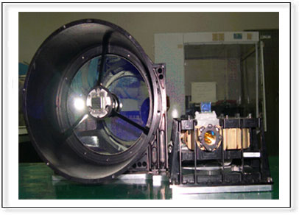
Lunar Ranging Instrument
Lunar Laser Ranging Instrument (LLRI) is aimed to study the topography of the Moon’s surface and its gravitational field by precisely measuring the altitude from a polar orbit around the Moon.
Altimetry data close to the poles of the Moon would also be available from the instrument.
Performs a very crucial task in Moon orbiters.

Slide 28
Lunar Ranging Instrument
Receiver Telescope
Receiver Electronics
FPGA
SN55LVDS31/2-SP
DS90LV031/2AQML
DS90C031/2QML
LVDS Interface
Laser Beam Emitter
Block schematic diagram of LLRI system.
Peak Detector
Avalanche Photodiode
THS4513
THS4304
Band Pass Filter
LMP2012QML
Pre- Amplifier
LMP2012QML
Attenuator & Post Amplifier
CFD
(constant fraction
digitizer)
Block schematic diagram of Front end Receiver Electronics
Back to Main
Payloads
Notes:
Lunar Laser Ranging Instrument (LLRI) proposed for the first Indian lunar mission Chandrayaan-1 is aimed to study the topography of the Moon’s surface and its gravitational field by precisely measuring the altitude from a polar orbit around the Moon. Altimetry data close to the poles of the Moon would also be available from the instrument.
The output of the Avalanche Photodiode passed through a bandpass filter and sent to the amplifier section. The CFD unit compares it’s input with the emitted laser beam (Phase Comparison) and hence the altitude is determined accordingly.

Slide 29
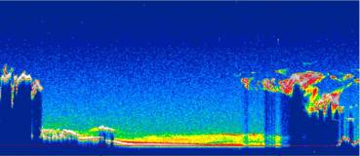
CALIOP (LIDAR)
The Cloud-Aerosol LIDAR with Orthogonal Polarization (CALIOP) will provide profiles of total backscatter at two wavelengths, from which aerosol and cloud profiles will be derived.
Images of an oil spill from CALIOP is show below.

Slide 30
CALIOP(LIDAR)
LMP2012QML
Pre- Amplifier
LM98640QML
14-Bit,
@10MSPS
FPGA
SN55LVDS31-SP
DS90LV031AQML
DS90C031QML
LVDS Driver
Avalanche PhotoDiode
LMP2012QML
Pre- Amplifier
LM98640QML
14-Bit,
@10MSPS
TLK2711-SP
1.6 – 2.5 Gbps
SerDes
Transceiver
Clocking Components
CDCM7005-SP
Clock Synchronizer & Jitter Cleaner
ADC Clock
SerDes Clock
To other
FPGAs
FPGA Clock
To FPGA
TPS50601-SP
DC-DC
Point-Of-Load
Controller
TPS7H1101-SP
Low Dropout
Regulator
V_{DO} =200mV
Power
To
Multiple
Devices
Back to Main
Payloads
Notes:
The Cloud-Aerosol LIDAR with Orthogonal Polarization (CALIOP) will provide profiles of total backscatter at two wavelengths, from which aerosol and cloud profiles will be derived.
Uses two 14-bit ADCs to get a effective resolution of 22-Bits. Typical Sampling rate is 10MSPS. The Pre-Amplifier section is optional. The PGA in the ADC can be used to get the required signal strength. If this method is used, then a buffering stage will be required between the APD and the ADC. The digital data is sent to the FPGA and then to the OBC using the LVDS Driver and the SerDes. The control signals can be sent using the LVDS interface and the data using the SerDes.

Slide 31
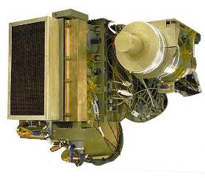
X-Ray and Gamma Ray Spectroscopy
The XGRS is a remote sensing instrument. From orbits of 35 to 100 km, it remotely senses the characteristic X-ray and gamma-ray emissions from the asteroid surface.
Remote sensing of this type is only possible for bodies with little or no atmosphere to absorb these emissions.
It also aims to study solar flares.

Slide 32
X-Ray & Gamma Ray Spectroscopy
CZT/PMT Detector
THS4513-SP
THS4511-SP
Pre-Amplifier
Pseudo Gaussian Shaper
ADC128S102QML
12-Bit, up to
200kSPS
SN55LVDS31-SP
DS90LV031AQML
DS90C031QML
LVDS Driver
FPGA
To other
FPGAs
Clocking Components
CDCM7005-SP
Clock Synchronizer & Jitter Cleaner
ADC Clock
FPGA Clock
To FPGA
TPS50601-SP
DC-DC
Point-Of-Load
Controller
TPS7H1101-SP
Low Dropout
Regulator
V_{DO} =200mV
Power
To
Multiple
Devices
Back to Main
Payloads
Notes:
The XGRS is a remote sensing instrument. From orbits of 35 to 100 km, it remotely senses the characteristic X-ray and gamma-ray emissions from the asteroid surface.
It also aims to study solar flares.
The CZT (Cadmium Zinc Telluride) or the PMT ( Photon Multiplier Tube) requires a fast response Pre-Amplifier (High BW and Slew Rate). The output of the amplifier is usually spikes. This signal is given a proper shape using a Analog or Digital Pseudo Gaussian Shaper. The final stage of the Pseudo Gaussian Shaper is a LPF. This signal is sampled and sent to the OBC using the LVDS interface.

Slide 33
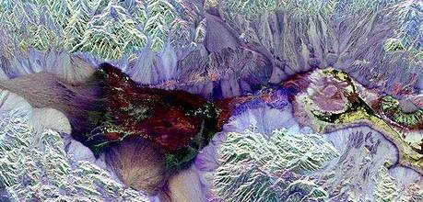
Synthetic Aperture RADAR
Synthetic-aperture radar (SAR) is a form of radar whose defining characteristic is its use of relative motion, between an antenna and its target region, to provide distinctive long-term coherent-signal variations, that are exploited to obtain fine spatial resolution.
Synthetic Aperture Radar (SAR) Payload enables imaging of the surface features during both day and night under all weather conditions.
Image of death valley taken from the SAR is shown below.

Slide 34
Synthetic Aperture Radar
THS4511-SP
LMH6702QML
Low Noise Amplifier
Mixer
THS4513-SP
THS4304-SP
IF Amplifier
Phase Detector
ADS5463-SP
ADS5400-SP
ADC10D1000QML
ADC12D1600QML
ADC08D1520QML
High Speed ADC
Antenna
Local Oscillator
SN55LVDS31-SP
DS90LV031AQML
DS90C031QML
LVDS Driver
FPGA
To other
FPGAs
TLK2711-SP
1.6 – 2.5 Gbps
SerDes
Transceiver
To other
FPGAs
To FPGA
Clocking Components
TPS50601-SP
DC-DC
Point-Of-Load
Controller
TPS7H1101-SP
Low Dropout
Regulator
V_{DO} =200mV
Power
To
Multiple
Devices
CDCM7005-SP
Clock Synchronizer & Jitter Cleaner
ADC Clock
FPGA Clock
Back to Main
Payloads
Notes:
Synthetic-aperture radar (SAR) is a form of radar whose defining characteristic is its use of relative motion, between an antenna and its target region, to provide distinctive long-term coherent-signal variations, that are exploited to obtain fine spatial resolution.
The frequency range used can vary from 1GHz-10GHz.

Slide 35
Communication System
The primary goal of the communication subsystem is to provide a link to relay
data findings and send commands to and from the Satellite.
The main function of a Communication system are:-
  Transmit Telemetry Signals
  Receive Tele-command Signals
  Transmit Payload data
The communication from satellite to ground station is called downlink and from ground station to satellite is called uplink.

Slide 36
Communication System
RF Front-End
THS4511-SP
LMH6702QML
High Speed Amplifier
ADS5400-SP
ADC10D1000QML
ADC12D1600QML
ADC08D1520QML
High Speed ADC
RF Antenna
FPGA
SN55LVDS31-SP
DS90LV031AQML
DS90C031QML
LVDS Driver
TLK2711-SP
1.6 – 2.5 Gbps
SerDes
Transceiver
Filtering& Power
Stage
DAC5675A-SP
DAC5670-SP
High Speed
DAC
RF Antenna
CDCM7005-SP
Clock Synchronizer & Jitter Cleaner
ADC Clock
To other
FPGAs
Clocking Components
SerDes Clock
FPGA Clock
To FPGA
TPS50601-SP
DC-DC
Point-Of-Load
Controller
TPS7H1101-SP
Low Dropout
Regulator
V_{DO} =200mV
Power
To
Multiple
Devices
Back to Main
Notes:
The primary goal of the communication subsystem is to provide a link to relay data findings and send commands to and from the Satellite.
Different frequency bands for communication are:-
VHF band- 137-138 MHz – Downlink & 148-150 MHz – Uplink Ex:- Aryabhata, Rohini
S band- 2.2-2.29 GHz – Downlink & 2.025- 2.29 GHz – Uplink Ex:- IRS, SROSS
C band- 3.7-4.2 GHz – Downlink & 5.925-6.425 GHz – Uplink Ex:- INSAT, GSAT
Ku band- 11.45-11.7 GHz – Downlink & 14.0-14.5 GHz – Uplink Ex:- INSAT 2C/2D as redundancy.

Slide 37
THANK YOU!

Slide 38

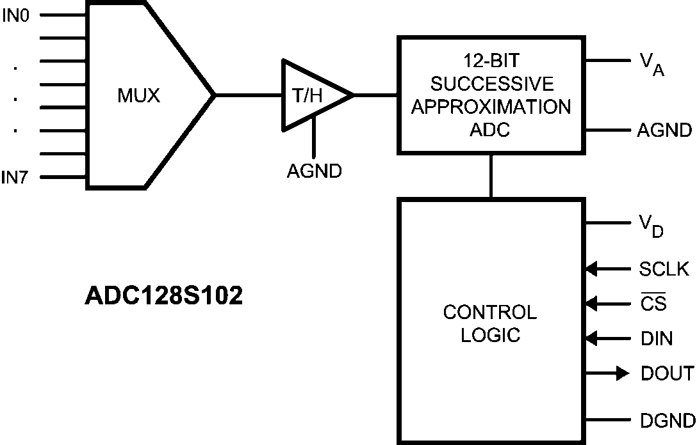

ADC128S102QML
8-Channel, 12-Bit, 50 KSPS to 1MSPS, ADC
Released
Features
Benefits
Eight Input Channels
Split Supplies
  VA 2.7V to 5.25V
  VD 2.7V to VA
Only 2.3mW of Power at 3V
  Power down 0.06 µW
DNL – -0.2 to +0.4 LSB typical
INL – +/- 0.4 LSB typical
SPI Digital Output
ADC addressing through CS decoder
SPI/QSPI/MICROWIRE/DSP compatible
Temperature Range: -55°C to +125°C
Available in 16-pin Ceramic SOIC
Eight sensors can be monitored with one ADC
All ADC serialized data shares the same input bus to onboard FPGA/ASIC
Ultra low power consumption
RHA Qualified For Space Applications
TID and SEU characterization data available for faster design in
SMD Orderable as 5962R0722701VZA
EVM PART # ADC128S102CVAL
Applications
  Sensors
  Thermistors
  Motor control
Rad Performance
  TID = 100kRad(Si)
  SEL and SEFI Immune > 120MeV-cm²/mg

Slide 39
ADC10D1000QML
10-bit Dual Channel 1 GSPS ADC
Released
Features
Benefits
Full Power Bandwidth of 2.8 GHz
9.0 ENOBs @ Fin 249MHz Fs – 1.0GHz
56.1dBc SNR @ Fin 249HMz Fs- 1.0GHz
62.1dBc SFDR @ Fin 249MHz Fs – 1.0GHz
1.45 W per channel at 1GSPS from single 1.9V supply
Very low cross-talk (-61 dB @ 497 MHz)
Low-noise deMUX’d LVDS outputs
Guaranteed no missing codes
SPI serial Interface
Internally terminated, buffered, differential analog inputs
Temperature Range: -55°C to +125°C
Available in 376-pin Ceramic Column Grid Array
Lowest power consumption on the market
Highest speed 10-bit space qualified ADC provides unmatched bandwidth, superb accuracy and dynamic performance
Ability to interleave the two channels to operate one channel at twice the conversion rate
Read/Write SPI Interface enables extended Control Mode
Meets space reliability requirements
RHA Qualified For Space Applications
TID and SEU characterization data available for faster design in
EVM PART # ADC10D1000CVAL
Applications
Satellite Communication Systems
Instrumentation
Rad Performance
TID = 100kRad(Si)
SEL and SEFI Immune > 120MeV-cm²/mg

Slide 40
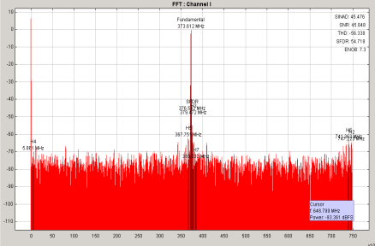
ADC08D1520QML
8-bit Dual Channel 1.7 GSPS ADC
Released
Features
Benefits
Max sampling frequency 1.7GSPS
Inputs may be interleaved to obtain a 3GSPS single ADC
Input bandwidth of 2 GHz
7.2 ENOBs out to Nyquist
1 W per channel at 1.5 GSPS from single 1.9V supply
Very low cross-talk (-66 dB @ 1160 MHz)
Low-noise deMUX’d LVDS outputs
Choice of SDR or DDR Output Clocking
1:1 or 1:2 Selectable Output Demux
Guaranteed no missing codes
Temperature Range: -55°C to +125°C
Available in 128-pin Ceramic Quad Gullwing
Lowest power consumption on the market
Higher performance than competing 10 bit ADCs
Radiation Qualified
RHA Qualified For Space Applications
TID and SEU characterization data available for faster design in
SMD Orderable as 5962F0721401VZC
EVM PART # ADC08D1520CVAL
Applications
  Satellite Communication Systems
Rad Performance
  TID = 300kRad(Si)
  SEL and SEFI Immune > 120MeV-cm²/mg

Slide 41
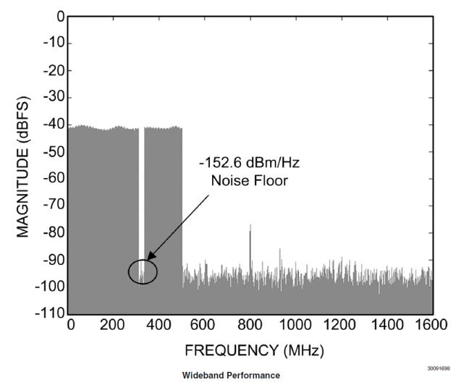
ADC12D1600QML
12-bit 3.2 GSPS ADC
Released
Features
Benefits
Dual Channel 1.6 GSPS
Single Channel Interleaved 3.2 GSPS
Low power sampling mode below 800 MSPS
Input bandwidth: 2.7 GHz
ENOB: 9.2/8.9 bits
SNR: 58.3/56.6 dB
SFDR: 67/62 dBc
Power: 2.8/3.8 W
Interleaved timing automatic /manual skew
Single 1.9V ± 0.1V power supply
Temperature Range: -55°C to +125°C
Available in 376-pin Ceramic Column Grid
  Lowest power consumption on the market
  Higher performance than competing 12 bit ADCs
  RHA Qualified For Space Applications
  TID and SEU characterization data available for faster design in
  Orderable as ADC12D1600CCMLS
Applications
  Satellite Communication System
  Wideband Communications
  Data Acquisition Systems
  RADAR/LIDAR
  Software Defined Radio
Rad Performance
  TID = 300 krad(Si)
  SEL and SEFI immune 120 MeV-cm²/mg

Slide 42
ADS5463-SP
High Performance 12-Bit 500MSPS ADC
RHA Now Available!
Released
Features
Benefits
High speed at 12-bits enhances resolution for radar and advanced imaging systems
Wide Bandwidth improves power amplifier linearization with a DPD solution; allows implementation of more standards in software-defined radio
High input frequency performance allows for the removal of an IF stage and simplifies IF design.
QMLV RHA qualified for space based applications
Orderable as SMD 5962-0720801VXC or 5962R0720802VXC
High Resolution Monolithic ADC; 12-bit, 500MSPS
SNR: 65.5dBFS @ 100 MHz fIN (500 MSPS)
SFDR: 80dBc @ 100 MHz fIN (500 MSPS)
10.5 Bit ENOB @ 100 MHz fIN (500 MSPS)
5V Operation; 2.25W Total Power Dissipation
3.3V LVDS Outputs
2.2 Vpp Input Range; 2GHz Input BW
Pin compatible with ADS5440, ADS5444
Temperature Range: -55°C to +125°C
Available in a 84 pin Ceramic Flatpack (HFG)
Applications
Instrumentation
Multichannel Receivers
Radar Systems
Communications Instrumentation
Rad Performance
TID = 100kRad(Si)
SEL > 86 MeV/(mg/cm2)

Slide 43
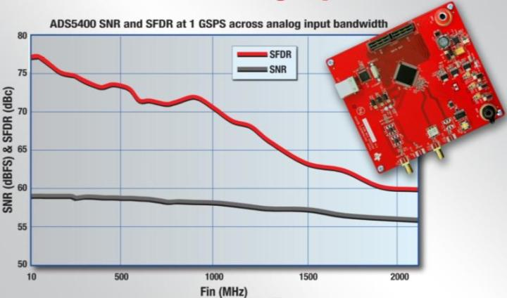
ADS5400-SP
Fully Buffered 12-Bit 1GSPS ADC with 2.1GHZ Input Bandwidth
Released
Features
Benefits
12-bit resolution with 1 GSPS sample rate
High dynamic performance from DC to 4th Nyquist
  59.1 dB SNR, 75 dBc SFDR at 250MHz
  58 dB SNR, 70 dBc SFDR at 1000MHz
On-chip inter-leaving trim adjustments
  For gain: range 1.5-2.0Vpp, resolution 120uV
  For offset: range +/-30mV, resolution 120uV
  For clock phase: range +/- 35ps, resolution 115fs
User selectable straight or de-muxed DDR LVDS
TI BiCom3 Technology with buffered input and 100 Ohm internal termination
2.2 Watt Power Dissipation
Temperature Range: -55°C to +125°C
Available in a 100 pin Ceramic Flatpack (HFS)
Highest speed 12-bit device available provides un-matched bandwidth
Highest SNR, SFDR and SINAD available for greater than 200MHz bandwidth systems
Enables multi-Gigasample digitizers to maintain 12-bit resolution & performance
Flexibility of reduced I/O speed or pin-count
Applications
Radar and Guidance Systems
Defense Electronics Digitizers
Space Based Instrumentation
Wireless Communication
Rad Performance
TID = 50kRad(Si)

Slide 44
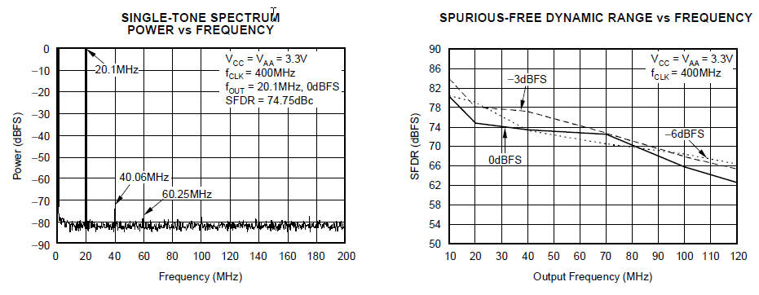
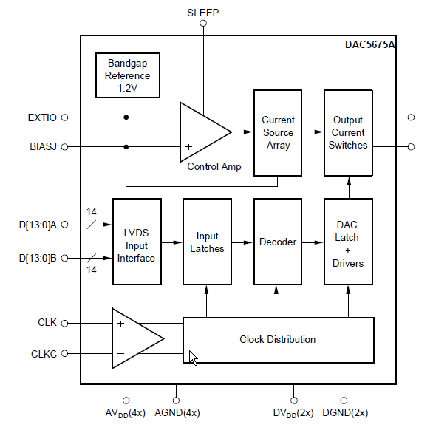
DAC5675A-SP
14-Bit, 400MSPS Current Steering DAC
Released
Features
Benefits
  14 Bit, 400 MSPS
  High Output IF: 200MHz
  3.3V analog and digital supplies
  Diff. Current Output: 20mA
  LVDS Interface: Low EMI, optimized for ASIC/FPGA Interface
  Flexible Clocking: SE/Diff, supports CMOS/TTL, (P)ECL, CW
  On Chip 1.2V Reference
  Hardware Sleep Mode
  Temperature Range: -55°C to +125°C
  Available in a 52 pin Ceramic Flatpack (HFG)
  Excellent AC Performance
Applications
  Arbitrary Waveform Generation
  Communications Test Equipment
  Direct Digital Synthesis
Rad Performance
  TID = 150kRad(Si)

Slide 45
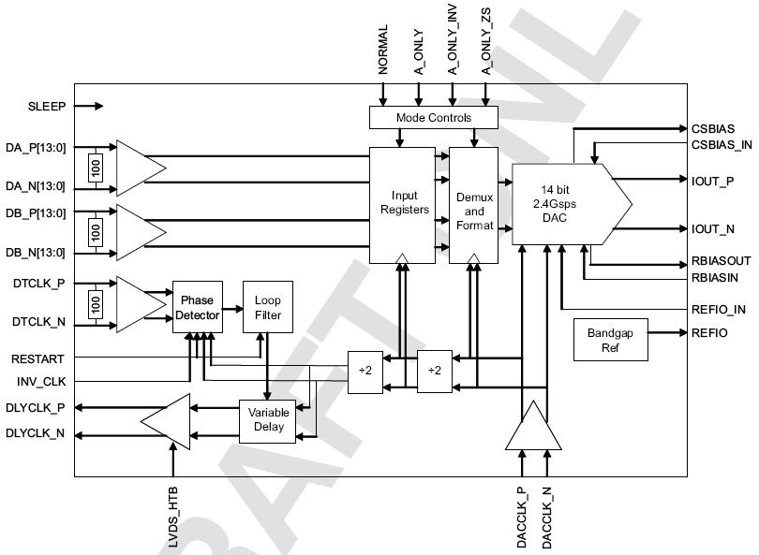
DAC5670-SP
14-Bit, 2.4GSPS Digital-to-Analog Converter
Released
Features
Benefits
  14-bit Resolution
  2.4 GSPS maximum update rate DAC
  Dual differential input ports
  Selectable 2x Interpolation with FS/2 Mixing
  3.3 V Analog Supply Operation
  On-Chip 1.2V Reference
  Differential Scalable Current Outputs:
  5 to 30 mA
  Power Dissipation: 2W
  Temperature Range: -55°C to +125°C
  192-Ball CBGA (GEM) Package
  QML-V Qualified For Space Applications
  Military Temp range: -55°C to 125°C
  Orderable Part Number: 5962-0724701VXA
Applications
  Point to Point Microwave
  Telecommunication Transceiver
  Direct Synthesis Modems
  Satellite Communications
Rad Performance
  TID = 150kRad(Si)

Slide 46
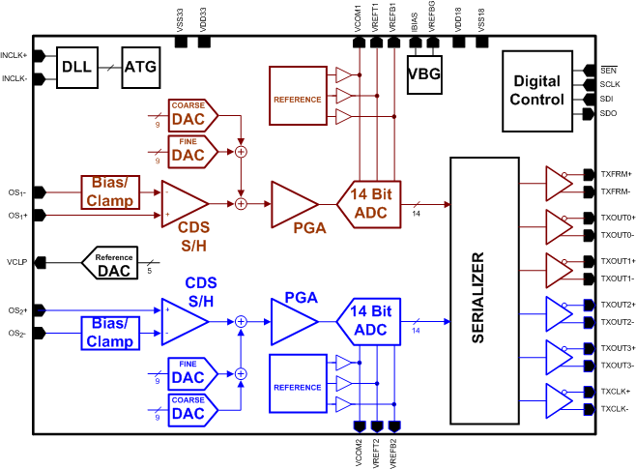
LM98640QML
Dual Channel, 14-Bit, 40 MSPS Analog Front End
Released
Features
Benefits
Fully integrated signal processing solution for imaging systems
Correlated Double Sampling or Sample/Hold Processing for CCD or CIS sensors
Serialized LVDS Outputs
  Dual lane at 16X sample rate or
  Quad lane at 8X sample rate
Programmable Sampling Edge up to 1/64th pixel period
Programmable Analog Gain for Each Channel
Programmable Analog Offset Correction
Programmable Input Clamp Voltage
Temperature Range: -55°C to +125°C
Enables digitization on focal plane
  No Cabling
  Reduced weight
  Low Power Consumption
Meets space reliability requirements
TID and SEU characterization data available for faster design in
  MLS Qualified For Space Applications
Applications
CCD Arrays
CMOS Image Sensors
Earth Observation
Star Tracker
EVM PART #
LM98640CVAL
Rad Performance
TID = 100kRad(Si)
SEL and SEFI Immune > 120MeV-cm²/mg

Slide 47
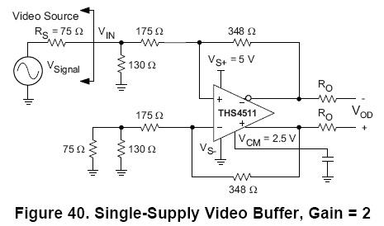
THS4511-SP
Fully Differential High-Speed Amplifier
Released
Features
Benefits
Minimum Gain= 0dB
Small Signal Bandwidth: 1600 MHz (G=0dB)
Slew Rate: 4900 V/µs (2V step, G=0dB)
Settling Time: 3.3ns (2V step, G=0dB, RL=100Ω, 0.1%)
HD2: -72dBc at 100MHz (2Vpp, G=0dB, RL=200Ω)
HD3: -87dBc at 100MHz (2Vpp, G=0dB, RL=200Ω)
Input Voltage Noise: 2nV/√Hz (f>10 MHz)
Output Common-Mode Control
+5V Single-ended Power Supply
Power-Down Capability: 0.65mA
Temperature Range: -55°C to +125°C
Available in 16-pin Ceramic FP (W) Package
Single-supply data acquisition systems
High Speed, High Resolution data acquisition
Robust input supports signals below the negative rail
Complementary SiGe Technology
  QML-V Qualified For Space Applications
Orderable as SMD 5962-07222
Applications
Military and Space
Wireless Infrastructure
Medical Imaging
Test and Measurement
Rad Performance
TID = 150kRad(Si)

Slide 48
THS4513-SP
Fully Differential High Speed Amplifier
Released
Features
Benefits
Minimum Gain: 1V/V (0dB)
Small Signal Bandwidth: 1100 MHz (G=6dB)
Slew Rate: 5100 V/µs (2V step, G=0dB)
Settling Time: 16ns to 0.1% (2V step, G=6dB, R_{L}=100Ω)
HD2: -75dBc at 70MHz (2Vpp, G=0dB, R_{L}=200Ω)
HD3: -86dBc at 70MHz (2Vpp, G=0dB, R_{L}=200Ω)
Input Voltage Noise: 2.2nV/√Hz (f>10 MHz)
Output Common-Mode Control
Power Supply Voltage: +3V to +5V
Power-Down Capability: 0.65mA
Temperature Range: -55°C to +125°C
Available in 16-pin Ceramic FP (W) Package
High Speed, High Resolution data acquisition
Complementary SiGe Technology
  QML-V Qualified For Space Applications
Orderable as SMD 5962-07223
Applications
Military and Space
Wireless Infrastructure
Medical Imaging
Test and Measurement
Industrial
Rad Performance
TID = 150kRad(Si)
THS4513 and ADS5500

Slide 49
THS4304-SP
Unity Gain, 1GHz, High Speed Amplifier
Released
Features
Benefits
Unity Gain Stable
Bandwidth: 1 GHz
(small signal unity gain)
0.01% Settling time:11ns (2V step)
Slew Rate: 800 V/μs
Voltage Noise: 2.4 nV/rtHz
HD2 @ 10 MHz: -67 dBc (2Vpp into 100Ω load)
HD3 @ 10 MHz: -100 dBc (2Vpp into 100Ω load)
Power Supply: 2.7V to 5V
Temperature Range: -55°C to +125°C
Available in 10-pin Ceramic FP (U) Package
Highest bandwidth and fastest settling time op amp available
BiCOM-III Process technology
  QML-V Qualified For Space Applications
Orderable as SMD 5962-0721901VHA
Applications
Satellite
Active Filters
ADC Driver
Medical – Ultrasound
Gamma Camera
RF/Telecom
Rad Performance
TID = 150kRad(Si)
ADS5500 Drive Circuit

Slide 50
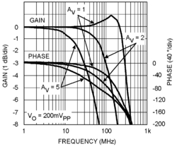
LMH6628QML
Dual Wideband Video Operational Amplifier
Released
Features
Benefits
Wide unity gain bandwidth: 300 MHz
Low noise 2nV/
Low Distortion: -65/-74dBc (10MHz)
Settling time: 12ns to 0.1%
Wide supply voltage range: ±2.5V to ±6V
High output current: ±85mA
Temperature Range: -55°C to +125°C
Available in 10-pin Ceramic DIP Package
High Speed
Low distortion
RHA Qualified For Space Applications
Orderable as SMD 5962F0254501VZA
Typical Performance
Applications
Satellite
Wide Dynamic-Range IF Amplifiers
Radar/communication Receivers
High-Speed dual Op-Amp
Rad Performance
TID = 300kRad(Si)

Slide 51
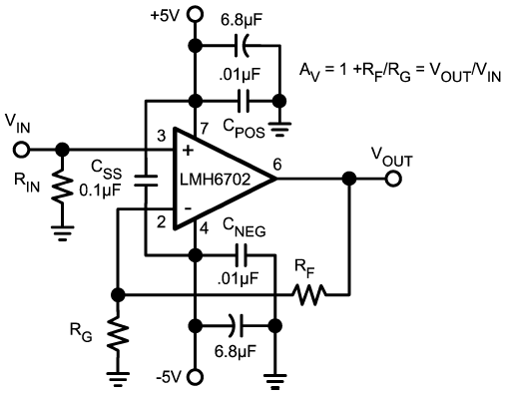
LMH6702QML
1.7 GHz, Low-Distortion, Wideband, Operational Amplifier
Released
Features
Benefits
V_{S} = ±5V, T_{A} = 25°C, AV = +2V/V, R_{L} = 100Ω, V_{OUT} = 2V_{PP}, Typical unless Noted:
HD2/HD3 (5MHz, SOT23-5) −100/−96dBc
−3dB BW (V_{OUT} =0.2V_{PP}) 720 MHz
Low noise 1.83nV/sqrtHz
Fast settling to 0.1% 13.4ns
Fast slew rate 3100V/μs
Supply current 12.5mA
Output current 80mA
Low IMD (75MHz) −67dBc
Temperature Range: -55°C to +125°C
Available in 8-pin Ceramic DIP and 10-pin Ceramic SOIC Packages
Wideband ADC driver
Ability to drive heavy loads
Minimized video distortion
RHA Qualified For Space Applications
Orderable as SMD:
  5962F0254602VPA
  5962F0254602VZA
Non-Inverting Gain Configuration
Applications
Satellite
Wide Dynamic-Range IF Amplifiers
Radar/Communication Receivers
High-Resolution Video
Rad Performance
TID = 300kRad(Si)
EVM PART # (LMH730216/NOPB, LMH730227/NOPB)

Slide 52
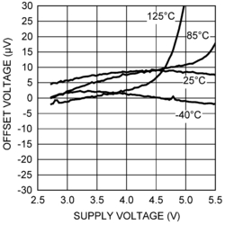
LMP2012QML
Dual, High Precision, Rail-to-Rail Output Operational Amplifier
Released
Features
Benefits
Low guaranteed VIO over temperature 60 µV
Low noise with no 1/f 35nV/
High CMRR: 90 dB
High PSRR: 90 dB
High AVOL: 85 dB
Wide gain-bandwidth product: 3 MHz
High slew rate: 4V/µs
Rail-to-rail output: 30mV
No external capacitors required
Temperature Range: -55°C to +125°C
Available in 10-pin Ceramic SOIC
Very Stable – Low temp co
QMLV qualified for space based applications
Orderable as SMD:
  5962L0620602VZA
  5962L0620601VZA
Typical Performance
Applications
Satellite
Gyroscopes
Star Trackers
Reaction Wheels
Rad Performance
TID = 50kRad(Si) and available as ELDRS free

Slide 53
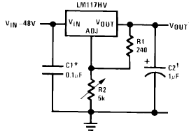
LM117HVQML
3-Terminal Adjustable Positive Voltage Regulator
Released
Features
Benefits
V_{IN} = 4.2V to 60V
V_{OUT} = 1.2V to 57V
Output Current: 500 mA or 1,500 mA
Load regulation typically 0.1%
Line regulation typically 0.01%/V
80 dB ripple rejection
Current limit constant with temperature
Output is short-circuit protected through floating regulator architecture
Temperature Range: -55°C to 125°C
Available in 3-pin TO39 (H) Package
Standard transistor packages are easily mountable
RHA Qualified For Space Applications
SMD Orderable: 5962R0722961VXA 5962R0722962VZA
Device | V_{IN} (V) | I_{OUT} (mA) | V_{OUT} (V) | I_{Q} (mA)
LM117HQML | 4.2 - 40 | 500, 1500 | 1.2 – 57 | 5
Applications
Satellite
Gyroscopes
Defense Electronics
Rad Performance
TID = 100kRad(Si)

Slide 54
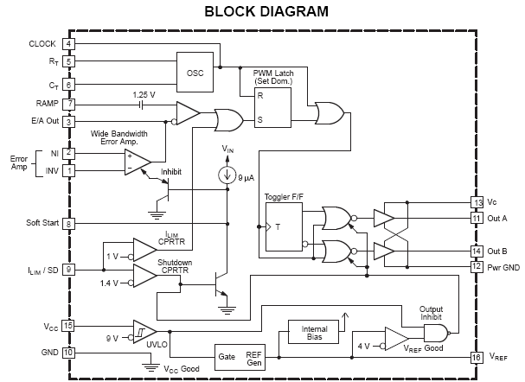
UC1825-SP
1 MHz High-Speed PWM Controller
Released
Features
Benefits
Voltage or Current-Mode Topology Compatible
Practical Operation Switching Frequencies to 1MHz
50-ns Propagation Delay-to-Output
High-Current Dual Totem Pole Outputs (1.5A Pk)
Wide Bandwidth Error Amplifier
Fully Latched Logic With Double-Pulse Suppression
Pulse-by-Pulse Current Limiting
Soft Start/Maximum Duty-Cycle Control
Undervoltage Lockout With Hysteresis
Low Start-Up Current (1.1 mA)
Temperature Range: -55°C to +125°C
Available in 16-pin Ceramic DIP (J) and Ceramic LCCC (FK) Packages
Can operate in current-mode or voltage mode
40kRad(Si)ELDRS Free
QMLV qualified for space based applications
Orderable as SMD 5962-8768104VxA
Applications
Satellite
Radar and Guidance Systems
Defense Electronics
Rad Performance
TID = 40kRad(Si) at Low Dose Rate
SEL Immune

Slide 55
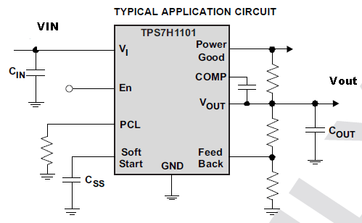
TPS7H1101-SP
7V, 3A Low Drop-Out Regulator
Development
Features
Benefits
V_{IN} = 1.5V to 7V
Ultra Low Dropout: 200mV (Max) at 3A
  PMOS Pass Device
2% Accuracy
Ultra Low Noise: (27x V_{OUT}) μV_{RMS}
PSRR: >45db up to 1 KHz
Programmable SoftStart
Programmable OCP, with current reading
Power Good Output (for Sequencing)
Temperature Range: -55°C to 125°C
Packaged in Thermally Enhanced 16-pin Ceramic Flatpack and Known-Good-Die (KGD) Packaged in Waffle Pak
ELDRS Free, RHA
SMD Orderable: TBD
Device | V_{IN} (V) | I_{OUT} (A) | V_{OUT} (V) | I_{Q} (μA) | PG | NR/SS | Enable | V_{DO} (mV)
TPS7H1101 | 1.5 – 7.0 | 3 | 0.8 – 6.1 | TBD | YES | YES | YES | 200
Applications
Power Management – LDO
RF Components VCOs, Receiver, ADC’s Amplifiers
High voltage, high PSRR, low noise and Clean Analog Supply Requirement Applications
Rad Performance
TID = 100kRad(Si)
SEL Latchup Immune to LET = 85 MeV

Slide 56
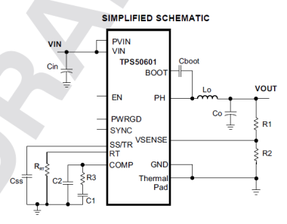
TPS50601-SP
3-6.3 Vin 6A Monolithic QMLV Point of Load DC-DC Converter
Released
Features
Benefits
Samples/EVMs available NOW
6A Output Current
PV_{IN} = 1.6V to 6.3V
Min Output Voltage to 0.8V
Integrated 55 mΩ High Side and 50 mΩ Low Side Power MOSFETs
Frequency programmable from 100 kHz to 1.0 MHz Switching Frequency
Synchronizes to External Clock
Parallel operation 180° out of Φ with Sync pin
Dynamic Bias feature
Integrated tracking function
Packaged in Thermally Enhanced 20-pin Ceramic Flatpack (HKH) and as tested die packaged in Waffle Pak in 3Q13
95% Peak Efficiency
Low V_{OUT} Optimized
Increases reliability and minimizes size
Improves load transient response with smaller output capacitances and Inductors
Eliminates Low Beat Frequency in Noise Sensitive Applications
Excellent for driving 12A+ power rails
Improves load transient response with smaller output capacitances
Ease of implementing sequencing schemes
WebBench™ design Software can be used
QMLV/RHA qualification pending
  5962-1022101VSC
Applications
Orbital observation Systems (e.g. Satellite, Shuttles, Space Stations)
Nuclear Facilities
Geological Exploration
Rad Performance
TID = 100kRad(Si)
ELDRS Free
SEL Latch up immunity > LET = 85 MeV‐cm²/mg
Notes:
The 6A Point-Of-Load DC/DC Converter is a QML Class-V qualified device and is a great choice for distributed power architectures.
We used the commercial TPS54620 SWIFT as the baseline design and optimized design for harsh envirinments such as space by specifically adding current-sources to the design, identifying the weak links and added capacitors to the design to stiffen things up. We optimized the Band-Gaps, to safeguard against “Soft-Start” !
It supports PV_{IN} = 1.6V to 7V, I_{OUT} up to 6A, and supports output voltages capable of a very low 0.8V.
Integrated 60 mΩ High Side and 30 mΩ Low Side Power MOSFETs have been sized to optimize efficiency for lower duty cycle applications. Click on the hypertext link Power MOSFETs in the feature bullets to see an animated system level visualization of these MOSFETs in action with the output voltage and current flow through the external inductor.
These integrated power MOSFETs allow for high-efficiency power-supply design and it delivers an efficiency of 93% peak-efficiency @ 1Amp and remains efficient to almost 90% at the parts full load of 6 Amps and offers increased reliability while minimizes the devices size. Click on the hypertext link 93% Peak-Efficiency in the benefits bullets to see the efficiency curve.
It has scalable frequency operation of from 100 kHz to 1.0 MHz Switching Frequencies which allows a 50% smaller Inductor value compared to earlier 12V SWIFT devices. The 100kHz enables higher efficiencies but with a larger size Inductor, while the 1MKz frequency produces slightly lower efficiencies but with smaller Inductor sizes.
The SYNC-pin feature supports 180° out of Φ for parallel operation-mode which allows for putting two in parallel to drive 12A+ power rails. It also eliminates Low Beat Frequency in Noise Sensitive Applications
Integrated tracking function makes it easy to implement Sequencing schemes.
We have also implemented a patented “Dynamic Bias” technique which improves load transient responses with smaller output capacitances. Click on the hypertext link Dynamic Bias in the features bullets to see additional transient response slide.
To address weight and solution size, we are offering the it in a 20-pin Ceramic Flatpack package & Known-Good-Die and will help customers optimize their designs with PCB board savings and layout efficiencies since this package is 54% more area efficient over closest competitor.
Finally, the POL device is supported by TI’s SwitcherPro™ design Software and SPICE models are available, we have samples today and will be releasing in early 2012.

Slide 57

SMV320C6701-SP
32-Bit, Floating-Point Digital Signal Processor
Released
Features
Benefits
Highest Performance Floating-Point Digital Signal Processor (DSP) SMV320C6701
  7-ns Instruction Cycle Time
  140 MHz Clock Rate
  Eight 32-Bit Instructions/Cycle
  Up to 1 GFLOPS Performance
  1M-Bit On-Chip SRAM
    512K-Bit Internal Program/Cache
    512K-Bit Dual-Access Internal Data
32-Bit External Memory Interface (EMIF)
Temperature Range: -55°C to +125°C
Available in 420-pin Ceramic BGA and LGA Packages
VelociTI Advanced Very Long Instruction Word (VLIW) ’C67x CPU Core
Glueless access to async/sync memory
QML-V Qualified
Orderable as SMD 5962-9866102VXA (BGA)
Orderable as SMD 5962-9866102VYC (LGA)
EMIF32
McBSP 0
Program Cache/Memory
(64KB)
McBSP 1
Applications
DMA Controller
4 Channel
Satellite
Radar and Guidance Systems
Defense Electronics
C67x™
DSP Core
HPI 16-bit
GPIO
Data Memory
(64KB)
Rad Performance
2 Timers
TID = 100kRad(Si)
SEL Immune to LET = 85MeV

Slide 58
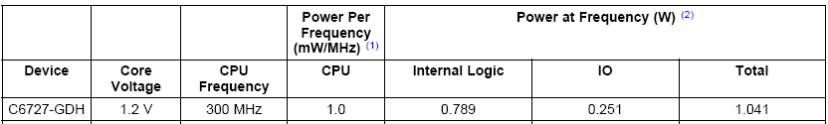
SM320C6727B-SP
32/64 Bit, Floating-Point Digital Signal Processor
Development
Features
Benefits
  250 MHz; 1500 MFLOPS
Memory
  256 KB of SRAM and 32 KB of I-Cache
  DSP/BIOS™/DSPLIB/FastRTS Library included in the device
Peripherals
  32-bit HPI for Connecting to Hosts
  dMAX Support for 1D, 2D, 3D Transfers
  as well as Multi-Tap Memory Delay
  Three McASPs
  Two I2C, two SPIs, 133 MHz/32-bit EMIF
  Utilizes BGR1 substrate engineering
Temperature Range:
  -55°C to +125°C
  -55°C to +115°C
Available in 256-pin Ceramic QFP Package
Offload resources from FPGA
RHA QML-V Qualified
256
SPI 0
KBytes
Instruction
C67x+™
I²C 0
SRAM
Cache
DSP
32 KBytes
Core
I²C 1
384K
ROM
Memory Controller
McASP 0
McASP 1
32-Bit
Config
EMIF
McASP 2
Applications
Switch
Satellite
Radar and Guidance Systems
Defense Electronics
HPI
DMA
SPI 1
RTI Timer
MAX
MAX
Rad Performance
Control
TID = 100kRad(Si)
SEL Immune to LET = 85MeV
dMAX

Slide 59
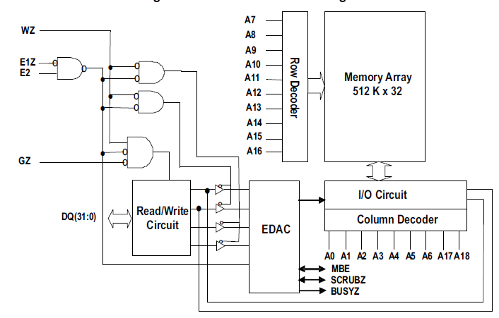
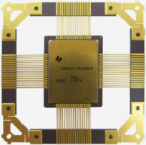
SMV512K32-SP
16-Mbit Asynchronous SRAM
Released
Features
Benefits
HARDSIL™ Radiation Hardening Technology
512K Words by 32 bit Asynchronous 16Mb SRAM
20ns Read, 13.8ns Write Maximum Access Time
200μA (Typ) Ultra low Standby Current (I_{SB})
Built-in Error Detection and Correction (EDAC)
Built-in Scrub Engine for autonomous correction (scrub frequency and delay are user defined)
CMOS compatible Input and Output levels
Three state bidirectional data bus
3.3V ±0.3V I/O & 1.8 ±0.15V CORE
Temperature Range: -55°C to +125°C
Available in 76-pin Ceramic QFP Package
Orderable through SMD: 5962-1123701VXC
Provides superior radiation performance with no SWAP (Size Weight And Power) tradeoffs
Functionally compatible with Commercial SRAMs
Enables industries lowest system-level power savings for space grade SRAMs
EDAC and Scrub engine enables lowest architecture and power overhead for autonomous Soft-Error mitigation
Radiation hardened Class V memory ensures reliability under harshest conditions
Applications
Orbital observation Systems (e.g. Satellite, Shuttles, Space Stations)
Nuclear Facilities
Geological Exploration
Rad Performance
TID = 300kRad(Si)
SER < 5e‐17 upsets/bit‐day
Proton upset saturation cross section < 3e‐16cm²/bit
Latch up immunity > LET = 110 MeV‐cm²/mg (T=125°C)
Notes:
The SMV512K32-SP is the HiRel groups first grounds-up Memory design that we partnered with “Silicon-Space-Technology” for inclusion of their HARDSIL™ radiation hardening technology.
The HARDSIL™ radiation hardening technology is essentially an expansion optimization of the radiation performance window by tweaking the processing technology with the circuit design with the layout of the device.
The HARDSIL™ technology provides superior radiation performance with no Size-Weight-And-Power (or SWAP) tradeoffs.
This ultra high performance Asynchronous CMOS SRAM is a Radiation-Hardened Memory and is organized as 512K Words by 32 Bits.
Since it is an Asynchronous Memory, it never needs a clock to refresh the memory and only Reads, Writes, ChipSelect Address, and Data need to be exercised.
The memory boasts the industries lowest Standby-Current of 200μA which enables the industries lowest power consumption for Space-grade SRAMs enabling significant system-level power savings !
It is pin selectable between Master and Slave modes, and Master-mode provides users with a user defined autonomous Error-Detection-And-Control (or EDAC) for detecting a single bit error from a radiation strike in the device.
Additionally, the built-in “Scrub” engine is included for autonomous cleansing of Single-Event-Errors. Remember, Memories that accumulate multiple radiation strikes will eventually arrive at a permanent “Multiple-Bit-Error” which is not correctable.
The combination of the EDAC and Scrub delivers Soft-Error-Rates (SER) < 5e-17 upsets per bit-day. This is the lowest architecture and power overhead for autonomous Soft-Error mitigation !
Finally, the SRAM is Latch up immunity > Linear Energy Transfer (LET) of 110 MeV‐cm2/mg which ensures reliable memory data integrity under harshest conditions (T=125°C).

Slide 60
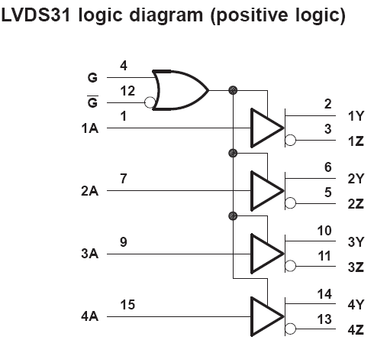
SN55LVDS31-SP
Quad LVDS Driver
Released
Features
Benefits
Low-Voltage Differential Signaling With Typical Output Voltage of 350 mV and 100W Load
500 psec Output Voltage Rise and Fall Times
Typical Propagation Delay Times of 1.7 nsec
Operate from a Single 3.3V Supply
25 mW Typical Power per Driver at 200 MHz
Driver at High Impedance when Disabled or V_{CC}=0
Bus-Terminal ESD Protection Exceeds 8-kV
Low-Voltage TTL (LVTTL) Logic Input Levels
Pin Compatible With AM26LS31,
Temperature Range: -55°C to +125°C
Available in 16-pin Ceramic DFP (W) Package
Designed for Use With Dual Differential Receiver SN55LVDS32-SP
QML-V Qualified for Space Applications per MIL-PRF-38535
Pin compatible and Interchangeable with Advanced Micro Device AM26LS31™
Non ITAR
Cold Sparing for Space and High Reliability Applications Requiring Redundancy
Applications
Satellite
Radar and Guidance Systems
Defense Electronics
Rad Performance
TID = 100kRad(Si)
SEL Immune to LET = 110MeV

Slide 61
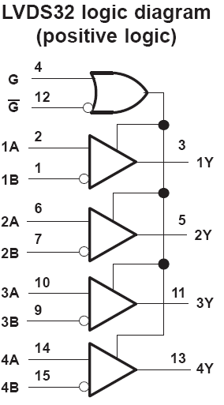
SN55LVDS32-SP
Quad LVDS Receiver
Released
Features
Benefits
Designed for Signal Rates of up to 100 Mbps
Differential Input Thresholds ±100 mV Max
Typical Propagation Delay Time of 2.1 nsec
Power Dissipation 60 mW Typical Per Receiver at Maximum Data Rate
Open-Circuit Fail-Safe
Operate from a Single 3.3V Supply
Bus-Terminal ESD Protection Exceeds 8-kV
Low-Voltage TTL (LVTTL) Logic Output Levels
Temperature Range: -55°C to +125°C
Available in 16-pin Ceramic DFP (W) Package
Designed for Use With Dual Differential Receiver SN55LVDS32-SP
QML-V Qualified for Space Applications per MIL-PRF-38535
Pin compatible and Interchangeable with Advanced Micro Device AM26LS32™
Non ITAR
Cold Sparing for Space and High Reliability Applications Requiring Redundancy
Applications
Satellite
Radar and Guidance Systems
Defense Electronics
Rad Performance
TID = 100kRad(Si)
SEL Immune to LET = 110MeV

Slide 62
DS90C031QML
LVDS Quad CMOS Differential Line Driver
Released
Features
Benefits
5V Supply
Supply current only 25 mA in operation
>155.5 Mbps (77.7 MHz) switching rates
High impedance LVDS outputs with power-off
Fail-safe logic for floating inputs
±350 mV differential signaling
400 ps maximum differential skew (5V, 25°C)
3.5 ns maximum propagation delay
Conforms to ANSI/TIA/EIA-644 LVDS standard
QMLV qualified
Temperature Range: -55°C to +125°C
Available in 16-pin Cermaic Flatpack and SOIC
High impedance LVDS outputs and fail-safe logic for cold sparing
Ultra low power consumption
Radiation (RHA) and Space (QMLV) qualified
SMD Orderable as 5962R9583301VxA
Applications
Internal Satellite Communication
Rad Performance
TID = 100kRad(Si)
SEL and SEFI Immune > 100MeV-cm²/mg

Slide 63
DS90C032QML
LVDS Quad CMOS Differential Line Receiver
Released
Features
Benefits
5V Supply
No load supply current only 11 mA
>155.5 Mbps (77.7 MHz) switching rates
High impedance LVDS inputs with power-off
Supports OPEN and terminated input failsafe
Accepts small swing (350 mV) differential signal levels
600 ps maximum differential skew (5V, 25°C)
Conforms to IEEE 1596.3 SCI LVDS standard
QMLV qualified
Temperature Range: -55°C to +125°C
Available in 16-pin Cermaic Flatpack and SOIC
High impedance LVDS inputs and fail-safe support for cold sparing
Ultra low power consumption
Radiation (RHA) and Space (QMLV) qualified
SMD Orderable as 5962L9583401VxA
Applications
Internal Satellite Communication
Rad Performance
TID = 50kRad(Si)
SEL and SEFI Immune > 120MeV-cm²/mg

Slide 64
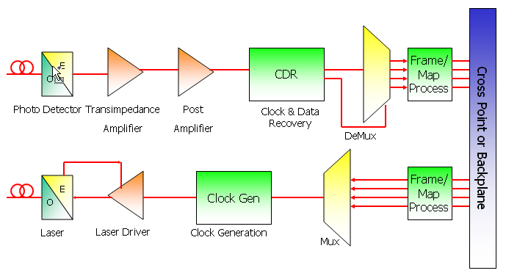
TLK2711-SP
Single 1.6 – 2.5 Gbps Transceiver
Released
Features
Benefits
1.6 to 2.5 Gbps Data Rate
Common 16:1 Serializer/ De-Serializer
LVTTL parallel side interface
VML driver with internal termination on Rx
Output Transmit Pre-Emphasis
Loss-Of-Signal Detection Circuitry
Built-in testability features
  PRBS generation and verification
  Internal Loop Back
Temperature Range: -55°C to +125°C
Available in 68-pin 14mm x 14mm Ceramic QFP (HFN) Package
Ultra-Low Power Consumption of 390mW
Ideal for GbE, Fibre-Channel, FireWire, Backplane Interface Between FPGA & Channel (Copper or Fiber) Applications
Capable of driving Cable Applications
Orderable as SMD 5962-0522101VXC
Applications
Satellite
Radar Systems
Guidance Systems
Rad Performance
TID = 25kRad(Si)
SEL Immune LET = 65MeV

Slide 65
LMH6702QML
1.7 GHz, Low-Distortion, Wideband, Operational Amplifier
Released
Features
Benefits
V_{S} = ±5V, T_{A} = 25°C, AV = +2V/V, R_{L} = 100Ω, V_{OUT} = 2V_{PP}, Typical unless Noted:
HD2/HD3 (5MHz, SOT23-5) −100/−96dBc
−3dB BW (V_{OUT} =0.2V_{PP}) 720 MHz
Low noise 1.83nV/sqrtHz
Fast settling to 0.1% 13.4ns
Fast slew rate 3100V/μs
Supply current 12.5mA
Output current 80mA
Low IMD (75MHz) −67dBc
Temperature Range: -55°C to +125°C
Available in 8-pin Ceramic DIP and 10-pin Ceramic SOIC Packages
Wideband ADC driver
Ability to drive heavy loads
Minimized video distortion
RHA Qualified For Space Applications
Orderable as SMD:
  5962F0254602VPA
  5962F0254602VZA
Non-Inverting Gain Configuration
Applications
Satellite
Wide Dynamic-Range IF Amplifiers
Radar/Communication Receivers
High-Resolution Video
Rad Performance
TID = 300kRad(Si)
EVM PART # (LMH730216/NOPB, LMH730227/NOPB)

