Slide 1
ECE 5233 Satellite Communications
Prepared by:
Dr. Ivica Kostanic
Lecture 7: Satellite sub-systems (2)
(Section 3.5-3.7)
Spring 2014

Slide 2
Outline
Block diagrams of transponders
Satellite antenna systems
Examples
Important note: Slides present summary of the results. Detailed derivations are given in notes.

Slide 3
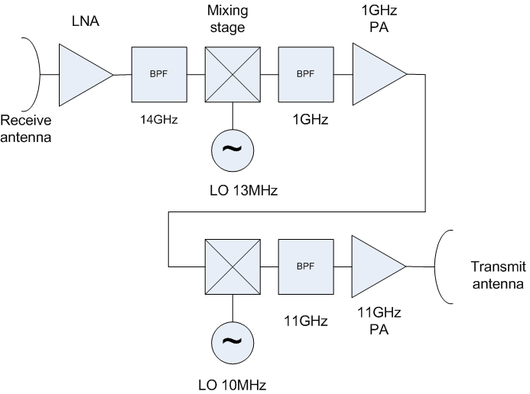
Simplified double conversion transponder
Easier to make cost and power efficient filters at lower frequencies
Two step conversion:
  From RX frequency to lower IF
  From lower IF to TX frequency
Signal processing and amplification done at IF
Two step conversion architecture common for Ku band (14/11 GHz band)
Drawback 2PAs
  HPAs are least reliable components
  Usually substantial redundancy is built – typically M:N = 2:1 (i.e. one spare HPA for every active one
Strict emission requirements – highly selective filters
Filters frequently followed by phase equalization circuits – extremely important for digital communication transponders
Outline of double conversion transponder architecture

Slide 4
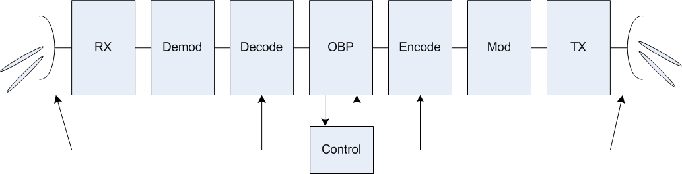
Regenerative transponders
On board processing
Transponder – “switch in the sky”
Usually deployed along with multi-beam antennas
  Beams are narrow – high gain
  Point to point communication provides link budget advantages
  Capacity of the link is increased – better spectrum utilization
Used in Ka band where antenna arrays are smaller (high operating frequency)
Switched beams, high-gain antennas increase re-use of the spectrum
Design of the satellite more complicated due to all of the processing requirements
On board processing increases latency
Simplified block diagram of a regenerative transponder

Slide 5
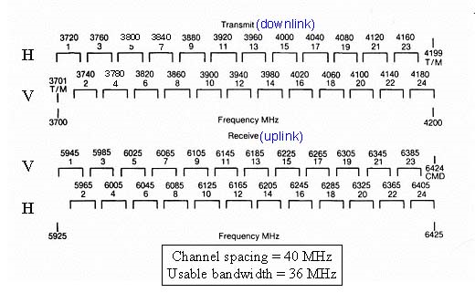
Satellite transponders – example of frequency plan
Total of 500MHz of spectrum available
Each transponder occupies 40MHz (36MHz for signal and 4MHz for guard band)
Frequency is reused through orthogonal polarization – allows separation of 20MHz between two transponder channels
Due to orthogonal polarization based frequency reuse – 24 transponders in 500MHz bandwidth
Each transponder is allocated a pair of frequency allocations
  Example: Transponder 3 works on horizontal polarization, transmits in the range 3740-3780MHz and receives 5965-6005MHz
Transponder is single manageable capacity unit of a satellite
Domestically price for a transponder capacity is about 1.5M$-2M$/year
Example of C-band frequency plan for IT region 2 (Americas)

Slide 6
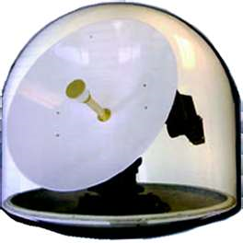
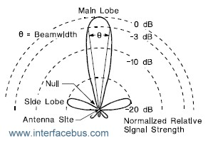
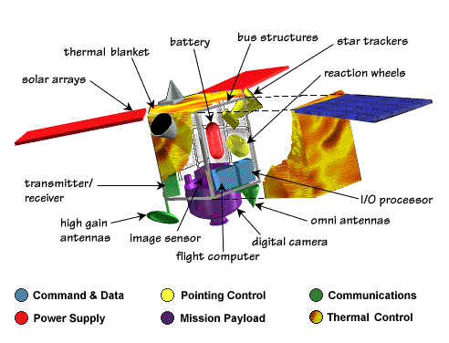
Antennas
Used for TX and RX of EM waves
Characterized by the
  Antenna gain
  Antenna pattern
  Beamwidth
  Efficiency
  Impedance
In satellite communication – antenna is critical
  Light weight
  High gain (narrow beam)
  High efficiency
  Polarization purity
Satellite usually has 2 antenna systems
  Communication
  TTC&M
Example of a satellite antenna
Antenna pattern parameters
Elements of a satellite
Note: 2 antennas

Slide 7
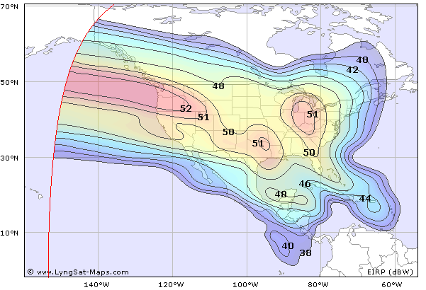
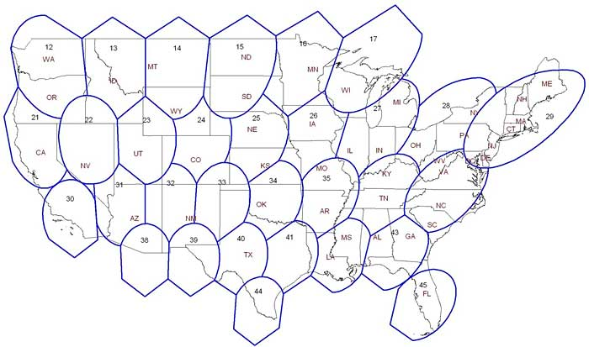
Types of satellite antennas
Wire antennas (UHF & VHF)
  TTC&M
  Mobile users on the ground
Horn + reflector antennas (dishes)
  Antenna arrays
  Feeds for reflectors (high gain)
Multiple feeds + reflector (phased arrays)
  Used to generate multiple beams
  Used for pattern shaping
Antenna coverage may be
  Global beam – cover as much as possible (17 degrees of beamwidth from GEO)
  Spot beams – cover smaller area on the ground
    Multiple switched beams
    Phase array beams
    Orthogonally polarized beams
AMC-6 coverage – example of global coverage
ViaSat (WildBlue) – example of spot beam global coverage

Slide 8
Basic relationships
Approximate relationships – used for nominal planning and feasibility studies
Gain of an antenna
3dB beamwidth of the antenna in degrees
D – dimension of the antenna in the beamwidth plane
A – antenna aperture in m^2
λ – wavelength in m
η_{A} – aperture efficiency (0.55-0.8)
Relationship between beamwidth and gain
For circular antenna with diameter D
Note: all antenna gains are linear

Slide 9
Examples
The Earth is viewed at the angle of 17 degrees form geo stationary orbit. What are dimensions of a horn antenna that provides global coverage at 4GHz? What would be a gain of that antenna?
Answer: D/λ = 4.4
at 4GHz, D = 0.33m
Gain: 20dB in the main beam
Continental US subtends angle of approximately 6 by 3 degrees when viewed from the geostationary orbit. What dimensions must reflector antenna have to illuminate half of the area with circular beam of 3 degrees at 11GHz? What would be dimensions of the reflector that illuminates the whole area? What is a gain of such antenna (assume 60% efficiency)?
Answer 1 : D = 0.68m
Answer 2: D1 = 0.68m, D2 = 034m
Answer 3: g = 32.6dB

Slide 10
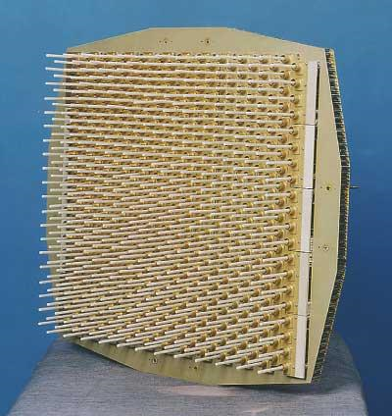
Some practical considerations
Antennas – often limiting elements
  High gain requirements
  Low beamwidth requirements
  High efficiency requirements
  Position an tracking requirements
  Beam shaping requirements – irregular beam shapes
Size of the antenna is inversely proportional to the frequency (i.e. directly proportional to the wavelength)
  As the frequency becomes higher smaller and more advanced antennas become possible
Ka band antenna array
(Harris, Melbourne, FL)

