Slide 1

"يرفع الله الذين آمنوا منكم والذين أوتوا العلم درجات"
صدق الله العلي العظيم
[ المجادلة : 11 ]

Slide 2
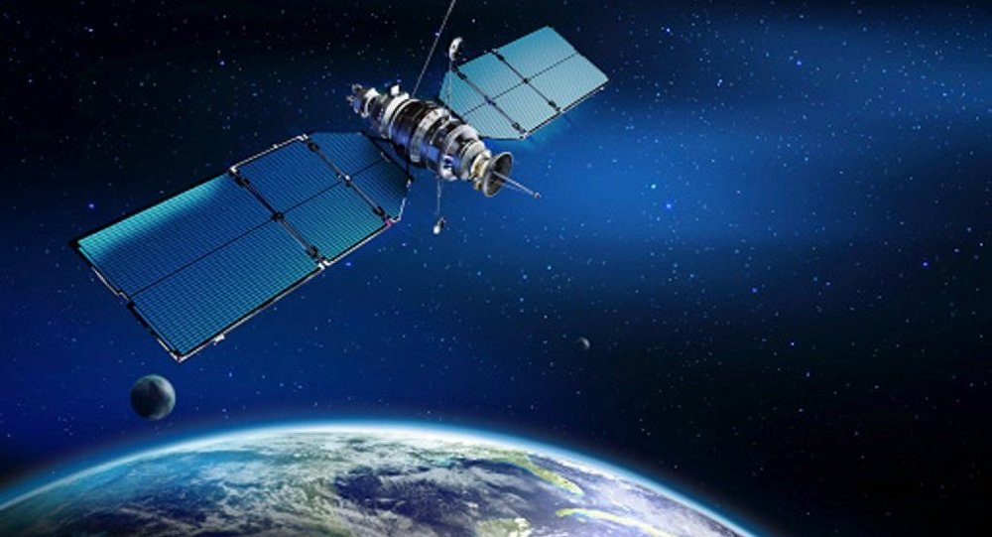
Satellites & communication
The project that changed the world.
SAIF HUSAM HADI
KARRAR SALIM JABAR
MAHDI MOHAMMED MOHAMMED

Slide 3
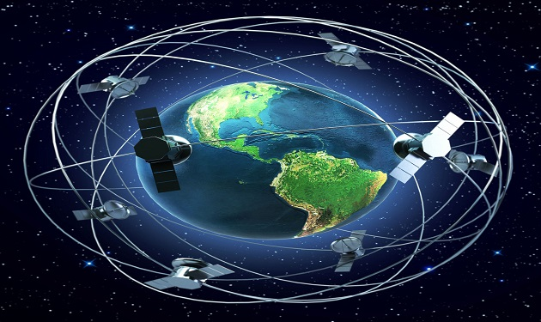
introduction
What Is A Satellite ?
When was first artificial satellite?
What Are The Types Of Satellite?
What Is Satellite Orbit ?
What Is Space Observatory?
What Is A Geostationary Satellite?
What Is Miniaturized Satellite?
What Is Communications Satellite?
What Is Global Navigation Satellite System?
What Is Space Station?

Slide 4
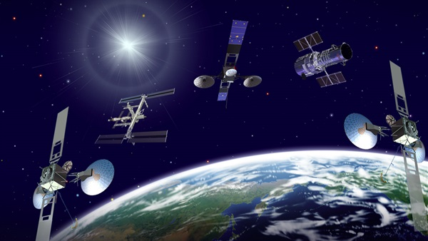
What Is A Satellite ?
Circling the earth, high above our heads, satellites are messengers and observers in the sky. They relay telephones calls, watch the weather, guide ships and aircrafts and carry out tasks that are impossible on the ground.

Slide 5
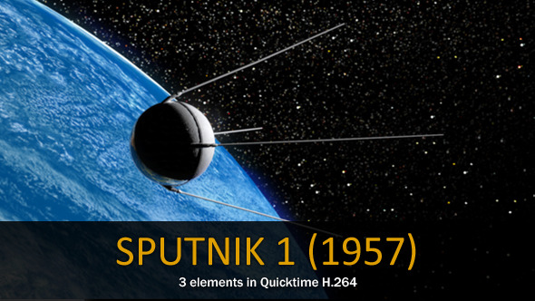
When was first artificial satellite?
On Friday, 4 October 1957, the Soviets had orbited the world's first artificial satellite. Anyone who doubted its existence could walk into the backyard just after sunset and see it. the Soviet Union launched the world's first artificial satellite, Sputnik 1.

Slide 6
What Are The Types Of Satellite?
Some Types of Satellite are as under:
Astronomical satellites
Biosatellites
Communications satellites
Miniaturized satellites
Navigational satellites
Earth observation satellites
Space stations

Slide 7
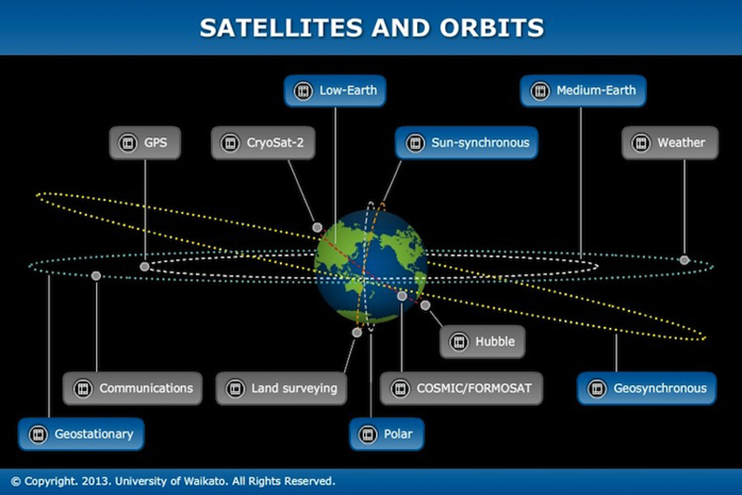
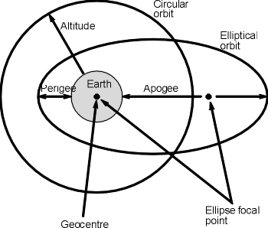
What Is Satellite Orbit ?
A satellite's orbit is the curved path it follows around earth. The pull of gravity is stronger closer to the earth, so a satellite in a low orbit must travel faster than one in a geostationary orbit.

Slide 8
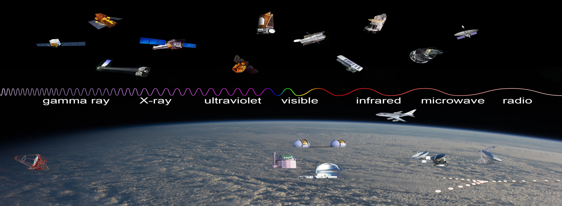
What Is Space Observatory?
A space observatory is any instrument in outer space which is used for observation of distant planets, galaxies, and other outer space objects. This category is distinct from other observatories located in space that are pointed toward the earth for the purpose of reconnaissance and other types of information gathering.

Slide 9
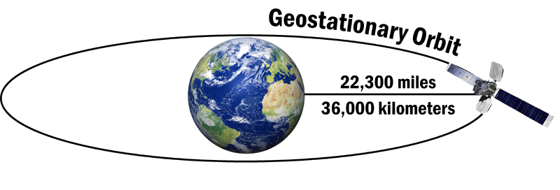
What Is A Geostationary Satellite?
Geostationary satellites are positioned at an height above the earth about 36000 Km. At this height they rotate around the earth at the same speed as the earth rotates around its axis, so in effect remaining stationary above a point on the earth (normally directly overhead the equator).
As they remain stationary they are ideal for use as communications satellites and also for remote imaging as they can repeatedly scan the same points on the earth beneath them.
Polar Orbiting satellites by comparison have a much lower orbit, moving around the earth fairly rapidly, and scanning different areas of the earth at relatively infrequent periods.

Slide 10
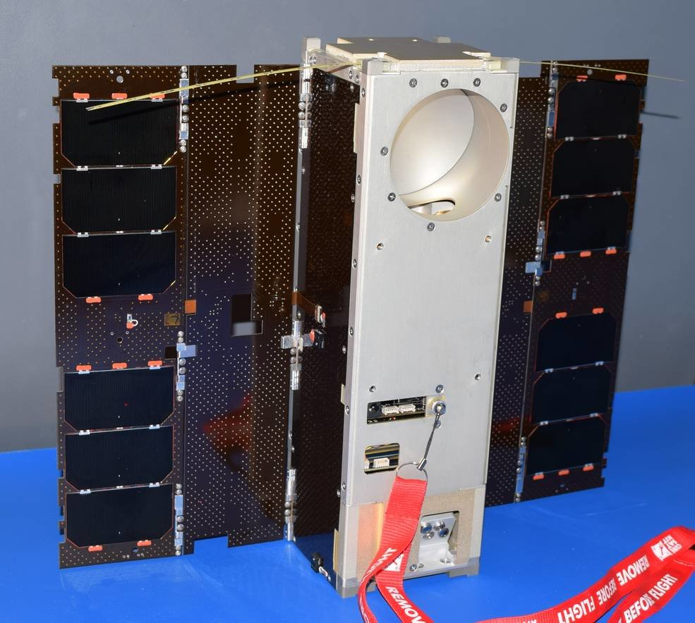
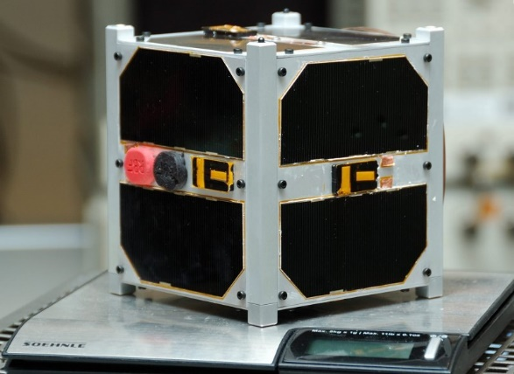
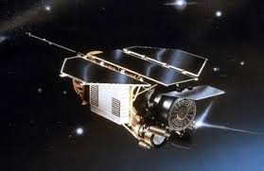
What Is Miniaturized Satellite?
Miniaturized satellites or small satellites are artificial satellites of unusually low weights and small sizes, usually under 500 kg. While all such satellites can be referred to as small satellites, different classifications are used to categorize them based on mass.

Slide 11
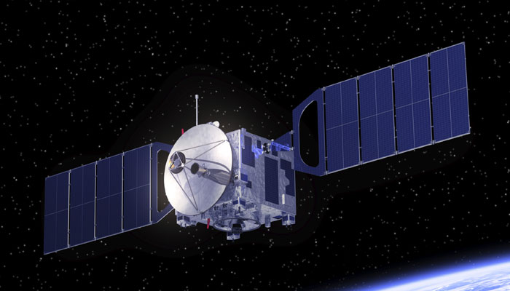
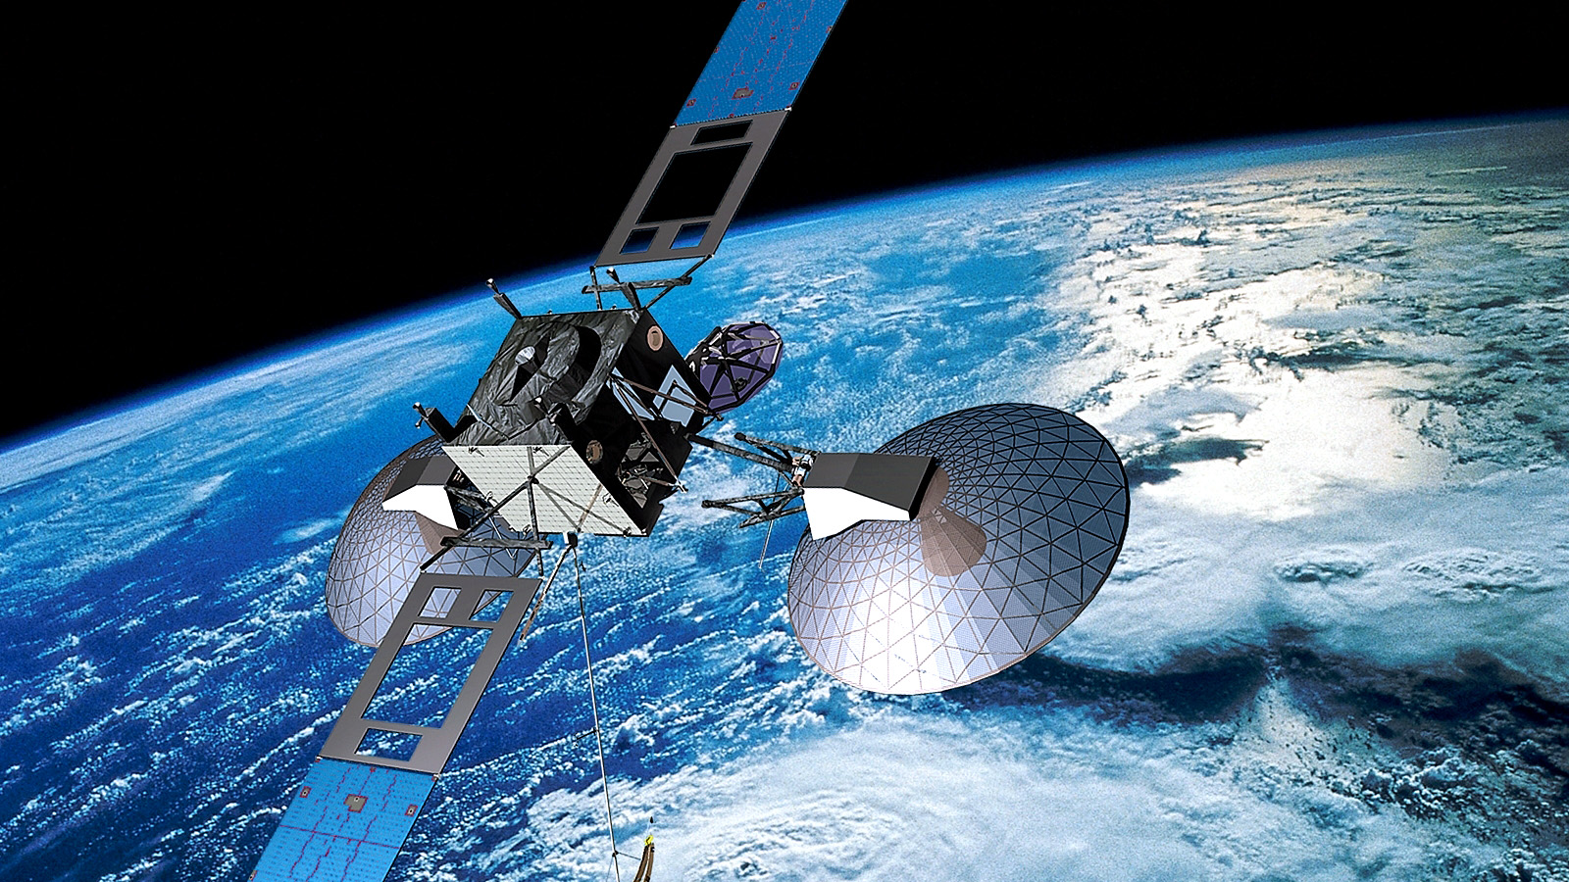
What Is Communications Satellite?
A communications satellite (sometimes abbreviated to COMSAT) is an artificial satellite stationed in space for the purpose of telecommunications. Modern communications satellites use a variety of orbits including geostationary orbits, Molniya orbits, other elliptical orbits and low (polar and non-polar) Earth orbits.

Slide 12
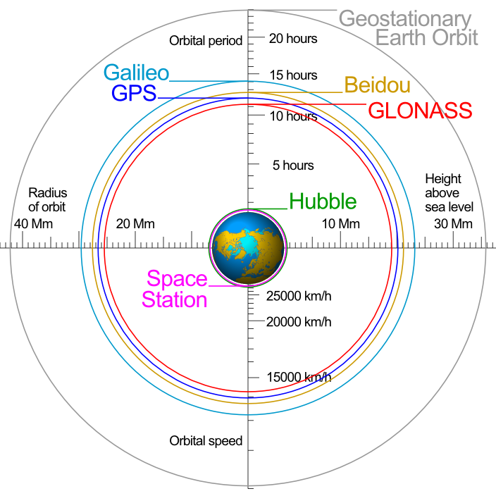
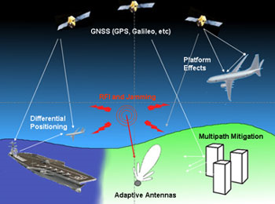
What Is Global Navigation Satellite System?
Global Navigation Satellite Systems (GNSS) is the standard generic term for satellite navigation systems
(“sat nav”) that provide autonomous geo-spatial positioning with global coverage. GNSS allows small electronic receivers to determine their location (longitude, latitude, and altitude) to within a few metres using time signals transmitted along a line-of-sight by radio from satellites. Receivers calculate the precise time as well as position, which can be used as a reference for scientific experiments.

Slide 13
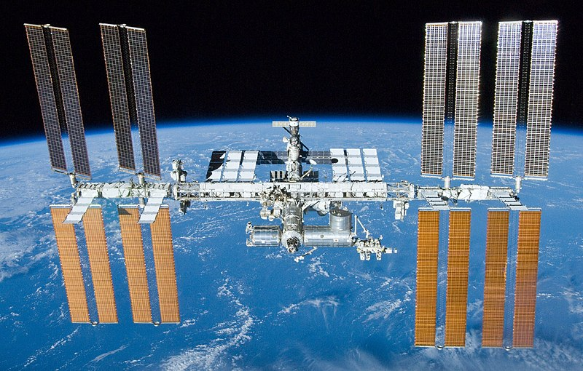
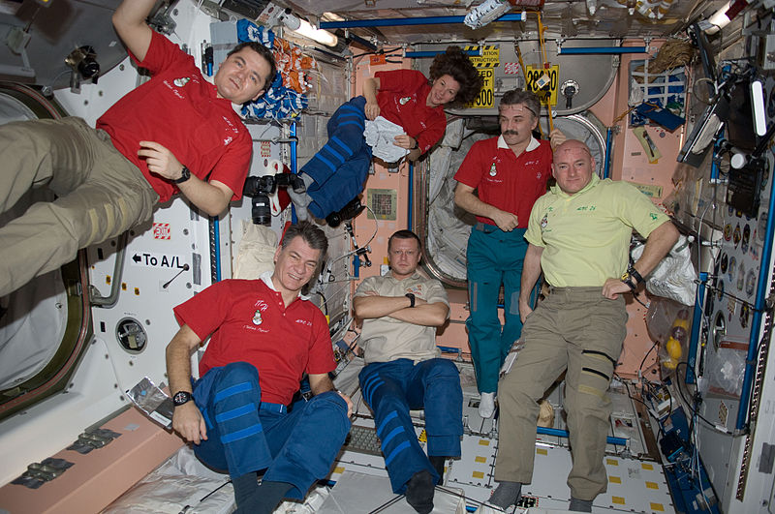
What Is Space Station?
A space station is an artificial structure designed for humans to live and work in outer space for a period of time.
To date, only low earth orbital (LEO) stations have been implemented, otherwise known as orbital stations. A space station is distinguished from other manned spacecraft by its lack of major propulsion or landing facilities—instead, other vehicles are used as transport to and from the station. Current and recent-history space stations are designed for medium-term living in orbit, for periods of weeks, months, or even years. The only space station currently in use is the International Space Station. Previous stations include the Almaz and Salyut series, Skylab and Mir.

Slide 14
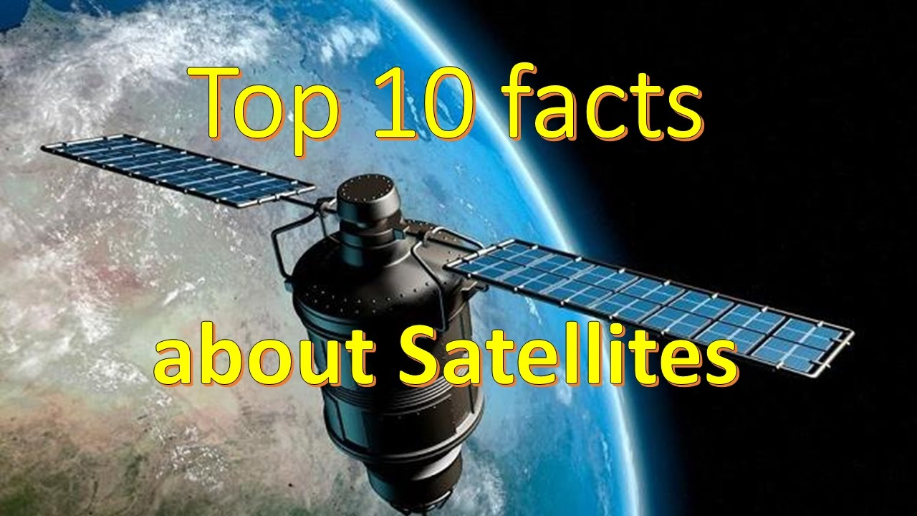

Slide 15
1. Sputnik 1 was about the size of a beach ball and took about 98 minutes to orbit the Earth.
2. Its launch is marked every year by International Space Week from October 4-10, a “celebration of science and technology, and their contribution to the betterment of the human condition”.
3. In the 16th century, the word “satellite” meant “an attendant on a person of importance” ...
4. ...In the 17th century it came to be used for a small planet revolving around a larger one.
5. In 2009 two communications satellites, from the US and Russia, collided. This is the only time two man-made satellites have collided by accident.

Slide 16
7. Polar satellites’ orbits pass over the poles so scan the whole Earth as it rotates beneath them.
6. Geostationary satellites orbit the equator at the speed of the Earth’s rotation so seem not to move.
8. More than 20 satellites make up the Global Positioning System, or GPS, enabling precise positions to be measured at any time.
9. There are now more than 2,500 artificial satellites in orbit around the Earth.
10. In 2012 satellite data showed that there were twice as many emperor penguins in Antarctica than was previously thought

Slide 17
Thanks for all your patience
The end

