Slide 1
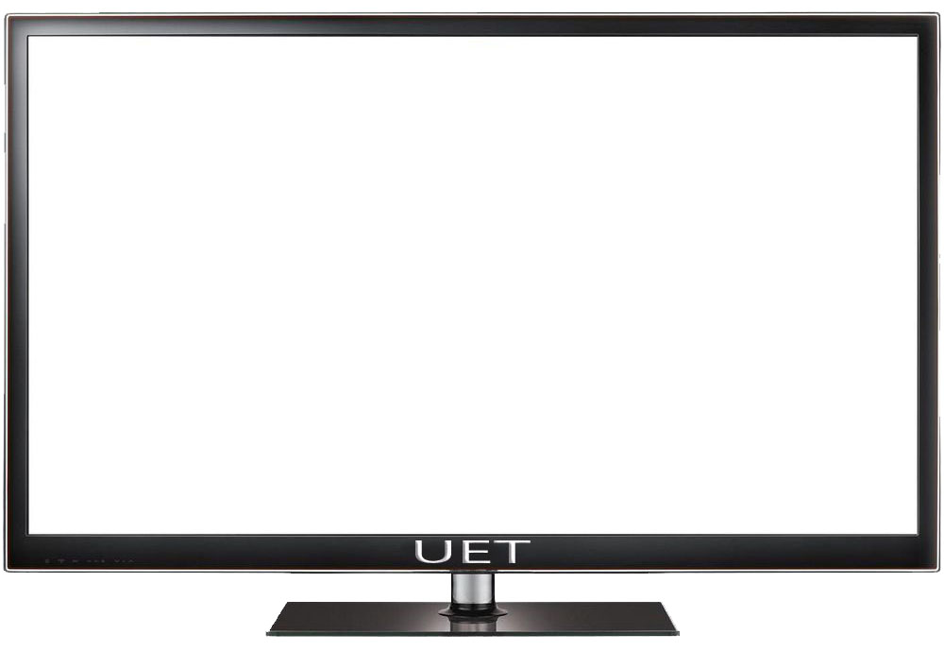


Slide 2
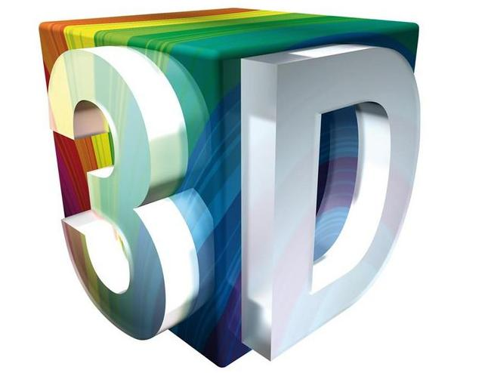
Technology and its Effects

Slide 3


Slide 4

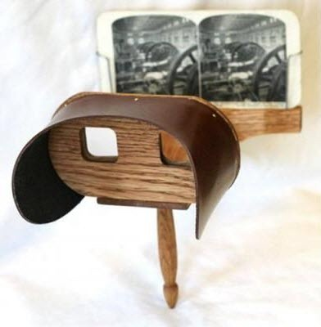
History
Watching movies in the third dimension might seem like space-age entertainment, but the technology is older than your great grand father.
According to sensio, a Canada-based manufacturer of 3D home Technology “Stereoscopic photography, or the technique of creating a ‘Third dimension’ was first invented in 1838”.

Slide 5
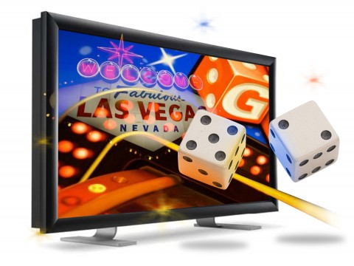
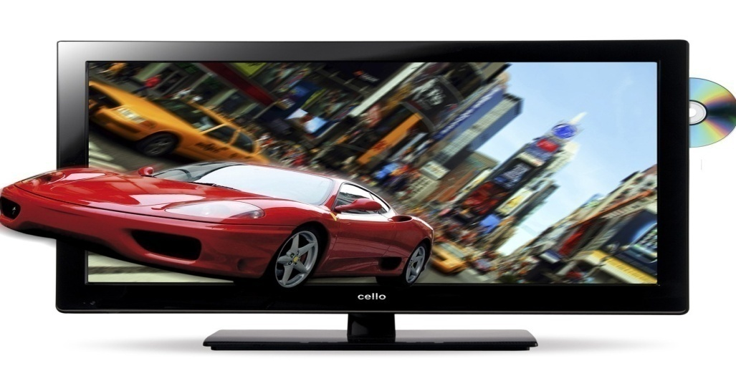
What Is 3D Technology
3D technology stands for three-dimensional technology.
3D technology is the illusion of depth, it is a visual representation system that tries to create or reproduce moving objects in the third dimension,
In simple that we have feel that whatever happens in 3D effect it is part of our real life.

Slide 6
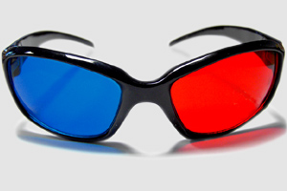
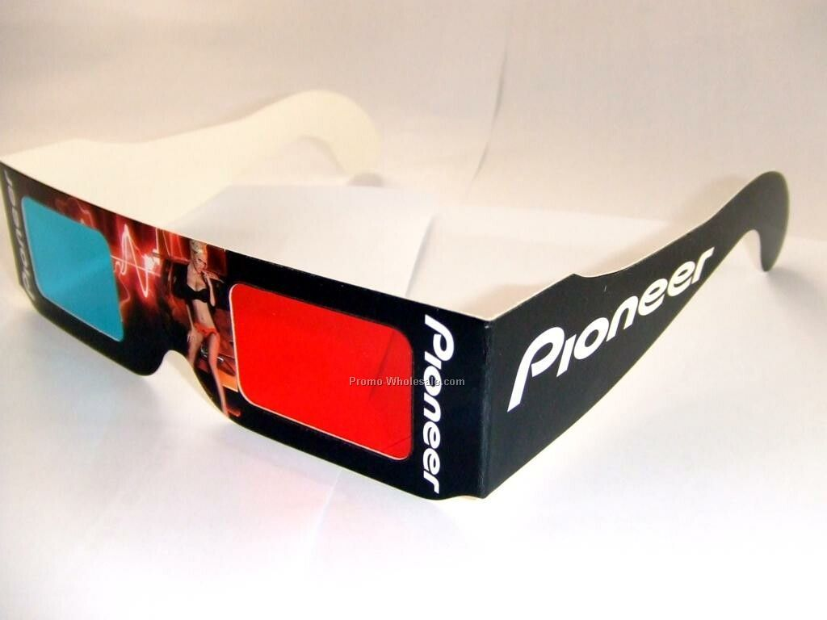
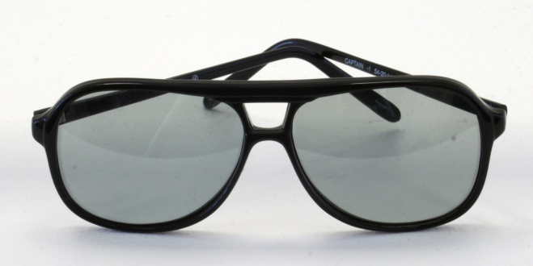
How we can see 3D images
Using 3D GLASSES
Types
1) Anaglyph 3D Glasses
2) Polarized 3D Glasses
3) Pulfrich 3D Glasses

Slide 7
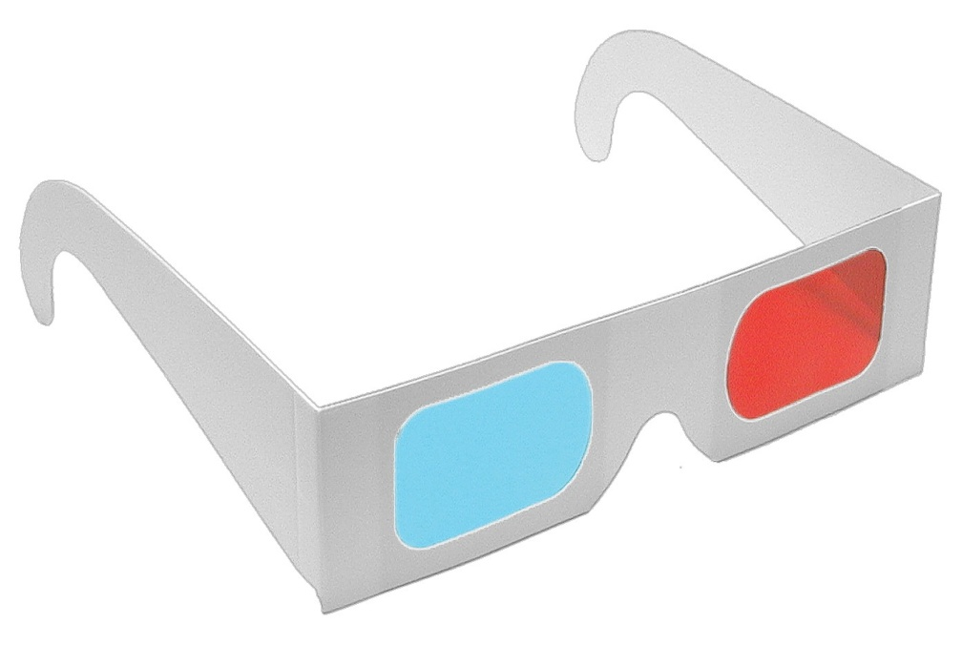
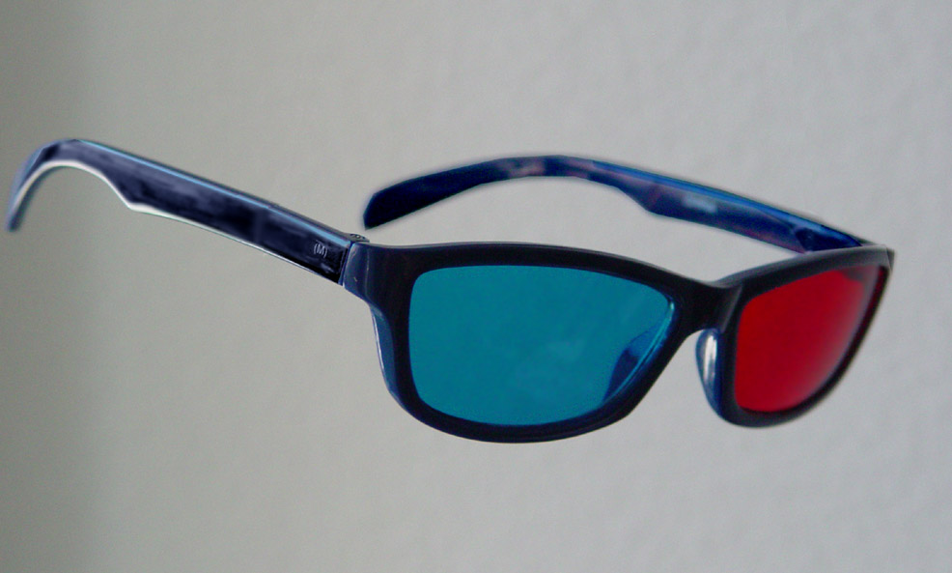
Anaglyph 3D Glasses
Lenses of red/blue or red/green for interpreting anaglyph art. Used for viewing 3D comics, 3-D web sites on the internet, movies and TV, 3D games, printing and art.

Slide 8
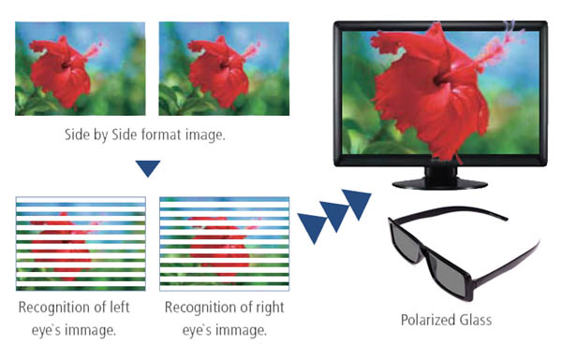
Polarized 3D Glasses
Both linear and circular polarizing lenses. Polarized 3D glasses are used for 3D laser shows, 3D ride simulators,multimedia displays.

Slide 9
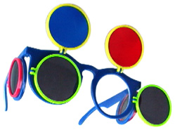
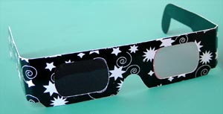
Pulfrich 3D Glasses
One dark and one clear lens, Pulfrich 3D glasses work with a object or scenes movies horizontally across the field of view. This is one of several ways to experience broadcast TV in 3D. The pulfritch method of 3D is used for TV, video and 3D computer displays.

Slide 10
How 3D technology works?
In a movie why you wear 3D glasses is to
feed different images in) your eyes just like a View-Master does. The screen actully displays two images, and The glasses cause one of the images to enter one eye and the other t enter the other eye. There are two common systems for doing this.
It is called stereoscopic technique.

Slide 11
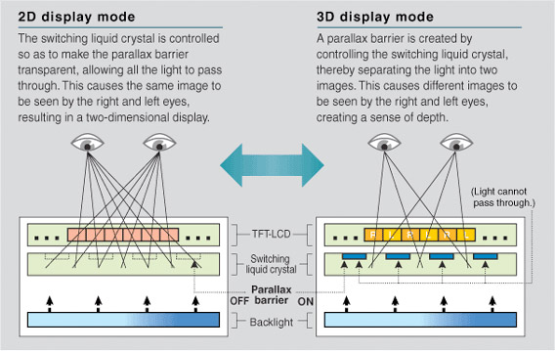
Difference Between 2D and 3D

Slide 12
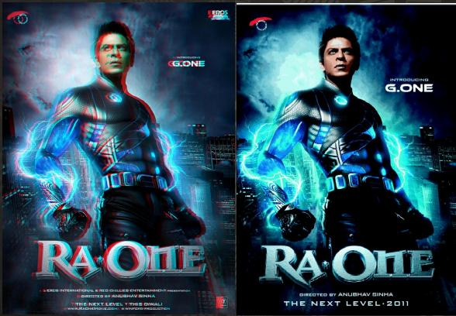
Differences
3D
2D

Slide 13
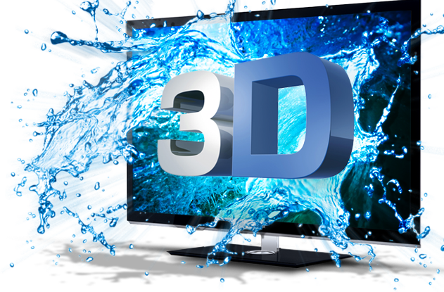
3D VIEWING

Slide 14
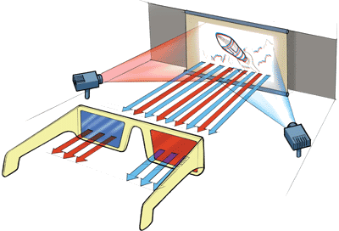
Red/Green or Red/Blue 3D Glasses
Although the red/green or red/blue system is now mainly used for television 3D effects, and was used in many older 3D movies. In this system, two images are displayed on the screen. One in red and the other in blue(or- Green). The filters on the glasses allow only one image to enter each eye, and your brain does the rest. You can’t have a really color movie when you are using color to provide the separation, so the image quality is not nearly as good as with the polarized system.

Slide 15
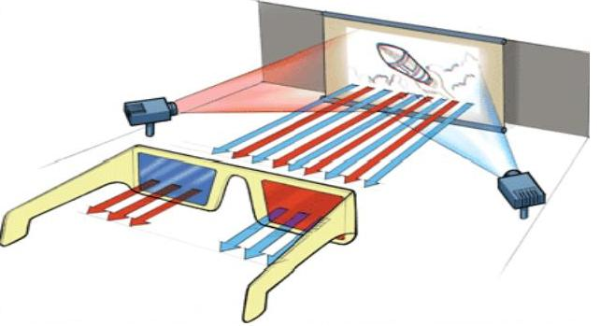
The red and blue lenses filter the two projected images allowing only one image to enter each eye.

Slide 16
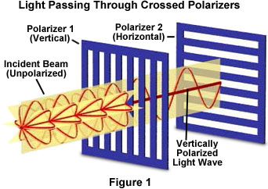
Polarization
At Disney world universal studio and other 3D values the preferred method uses polarized lenses because they allow color viewing. Two synchronized projectors project two respective views on to the screen. Each with a different polarization. The glasses allow only one of the images in to each eye because they contain lenses with different polarization.

Slide 17
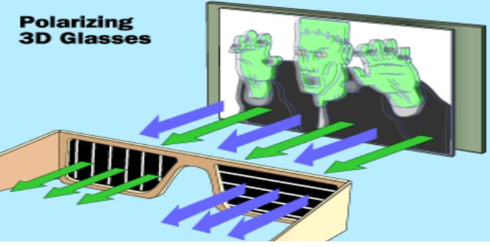
Polarizing 3D Glasses

Slide 18
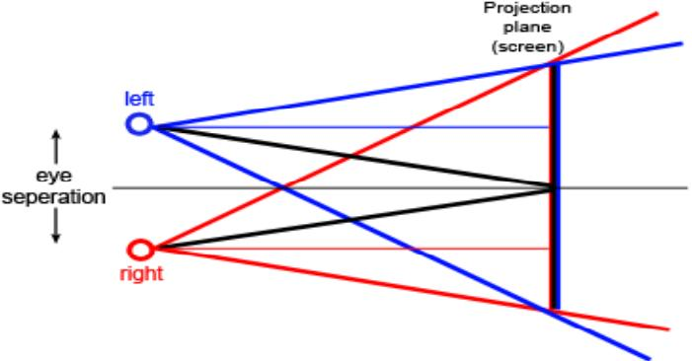
Cross eye Separation method

Slide 19

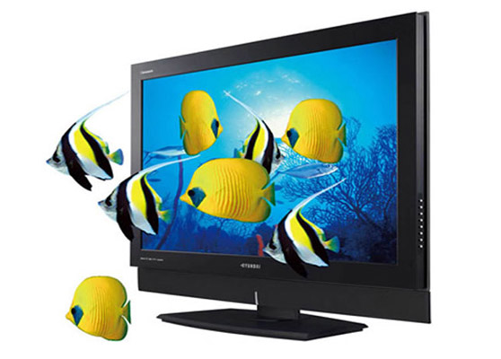
What are used of 3D Technology?
In making 3D films…
Likes Raone, Avatar, Don 2..
Making 3D display of television..
Making 3D games
Call of Duty
Dead Rising
Bat man

Slide 20
Companies
Apple
Toshiba
Samsung
Sony
Panasonic
Sharpe
LG

Slide 21
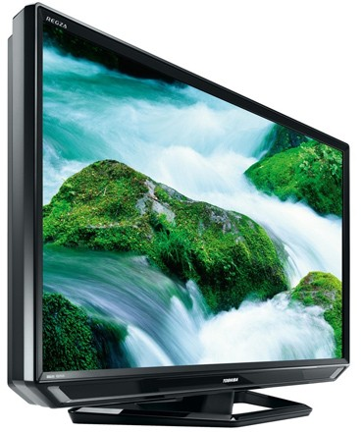
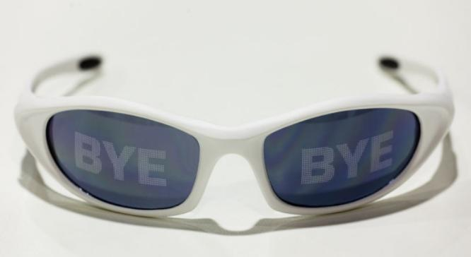
Interesting Facts
Worlds no 1 company Apple declared that it will make 3D IPod, and Laptop.
World’s famous company Toshiba found that New Technology we Can see 3D images without 3D glasses.
In 2010 Toshiba Has made one tv in which above system is Followed.

Slide 22
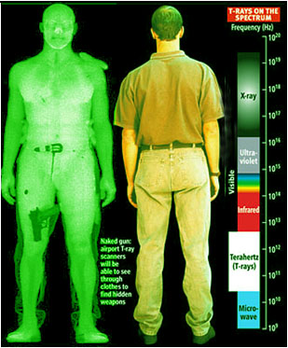
Ethical Implications
Developing 3D body measurement and body scan
  Used to increase safety measures
  Invasive
  May violate privacy

Slide 23

Ethical Implications
How 3D TV may affect your health
  May trigger epileptic seizure & stroke
  May damage eyesight
  May cause:
    motion sickness
    perceptual after effects
    disorientation
    eye strain
    decreased postural stability

Slide 24
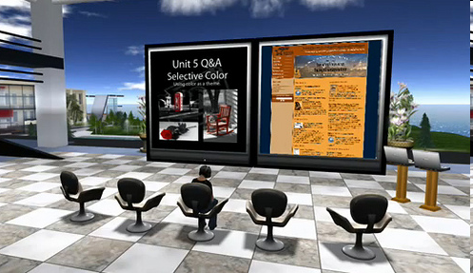
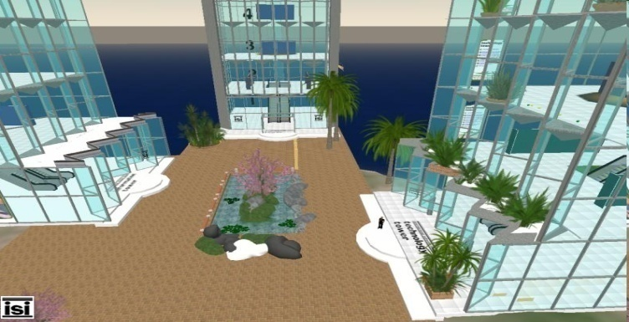
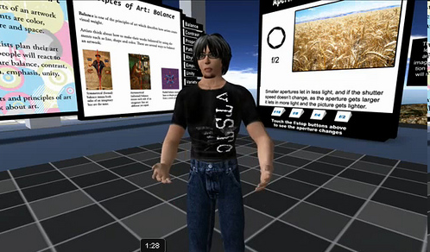
Nation-Building Implications
Could help other fields – architecture, communications, etc.
  Build more high standard infrastructure

Slide 25
Advatnages of 3D Technology
It is no secret that students of today live in a multimedia world where They use video as their primary form of engagement and communication.
Teachers and administrators are looking for ways to present information to student that will not only spark there interest but also encourage them to explore a subject more thoroughly.
The advent of affordable 3D technology promises to bring in to reality the Dream of fully engaged students.

Slide 26
Effecs of 3D technology
What are the disadvantages of 3D cinema ot television?
Valid disadvantages of current 3D technologies are:
Watching 3D content will always result in loss of brightness
2) The glasses are uncomfortable for people who don’t normally wear glasses.
3) The glasses are uncomfortable for people who do normally wear glasses because the 3D glasses must be worn over those existing glasses.
4) Shutter glass 3D technology requires on going maintenance. Passive 3D technology does not require much maintenance but it is also their to find on the consumer market.

Slide 27


Slide 28






QUESTIONS??????.....
?

