Slide 1
Authors:
Term project
wide comparison BETWEEN
H.264 AND HEVC
under the academic supervision of:
Gustavo Marrero Callicó
Sebastián López Suárez
Marcin Walendowski, Jakub Drynkowski, Weronika Woronicz

Slide 2
Index
Description and introduction to standards
  H.264
  HEVC
Comparison in terms of theoretical features
Simulation data
  H.264 and HEVC
  Comparison between simulations data
Conclusions
Bibliography

Slide 3
1.1
H.264/MPEG-4 AVC

Slide 4
Introduction
H.264 | MPEG-4 AVC
H.264/MPEG-4 AVC (ang. Advanced Video Coding)
  block-oriented motion-compensation-based video lossy compression standard
  Developed by the ITU-T VCEG and ISO/IEC MPEG
  The project partnership effort is known as the Joint Video Team (JVT)
  The standardization of the first version was completed in May 2003

Slide 5
General assumptions
H.264 | MPEG-4 AVC
  The intent was to create a standard capable of providing good video quality at substantially lower bit rates than previous standards( half or less in comparison with H.263)
Provide enough flexibility to allow the standard to be applied to a wide variety of applications on a wide variety of networks and systems, including low and high bit rates, low and high resolution video

Slide 6
Applications
H.264 | MPEG-4 AVC
Streaming internet sources
  Vimeo, YouTube and iTunes Store
Web software
  Adobe Flash Player and Microsoft Silverlight
HDTV broadcasts
  ATSC, ISDB-T, DVB-T,DVB-T2, DVB-C, DVB-S and DVB-S2
Blu-ray Discs
As a recording format
  AVCDC - Advanced Video Coding High Definition developed by Sony and Panasonic
  Uses by Canon and Nikon DSLRs
and more !

Slide 7
Comparison to previous standards
H.264 | MPEG-4 AVC
The H.264 video coding based on hybrid coding very similar to previous blocks standards (H.26x)
New features that allow it to compress video much more effectively than older standards and to provide more flexibility for application to a wide variety of network environments

Slide 8
New transform and quantization design
H.264 | MPEG-4 AVC - new key features
Adaptive encoder selection between the 4×4 and 8×8 transform block sizes for the integer transform operation.
Logarithmic step size control of quantization for easier bit rate management and simplified inverse-quantization scaling

Slide 9
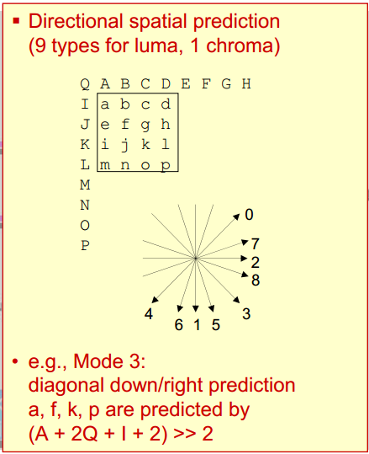
Intra Prediction
H.264 | MPEG-4 AVC - new key features
A multidirectional spatial prediction method to reduce spatial redundancy by using neighbouring samples as a prediction for the samples
Each MB can be encoded using blocks of pixels that are already encoded within the current frame

Slide 10
Multi-picture inter-picture prediction
H.264 | MPEG-4 AVC - new key features
Allowing up to 16 reference frames, in comparison with 1/2 for P/B frames in previous standard
Variable block-size motion compensation (VBSMC)
  block sizes include 16×16, 16×8, 8×16, 8×8, 8×4, 4×8, and 4×4

Slide 11
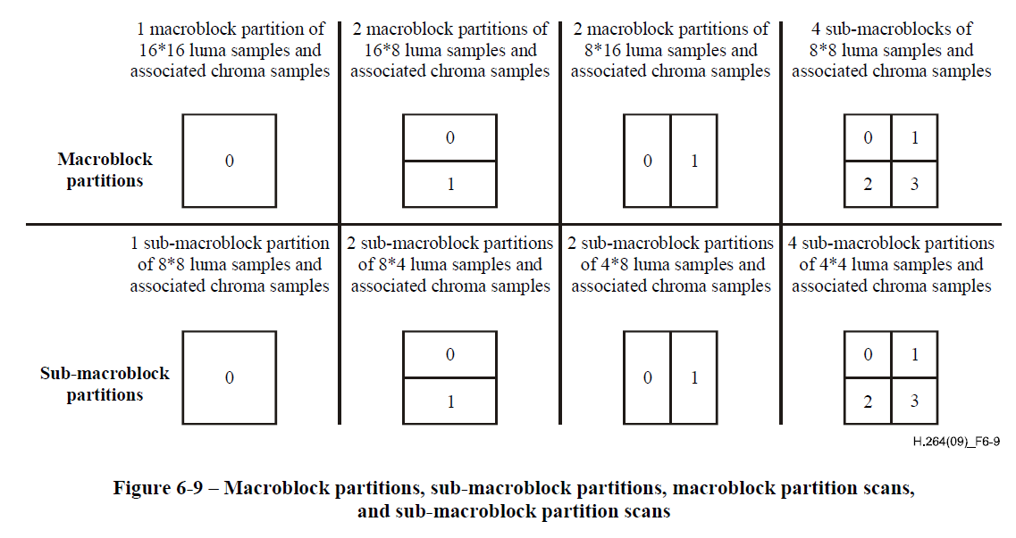
Multi-picture inter-picture prediction
H.264 | MPEG-4 AVC - new key features
Variable block-size

Slide 12
Multi-picture inter-picture prediction
H.264 | MPEG-4 AVC - new key features
The ability to use multiple motion vectors per macroblock. Up to 32 in the case of a B macroblock constructed of 16 4×4 partitions.
Quarter-pixel or even 1/8 pixel precision for motion compensation, enabling precise description of the displacements of moving areas.

Slide 13
Loop filter
H.264 | MPEG-4 AVC - new key features
An in-loop deblocking filter that helps prevent the blocking artifacts common to other DCT-based image compression techniques.
A filter is applied to every decoded macroblock to reduce blocking distortion
It results in better visual appearance and compression efficiency

Slide 14
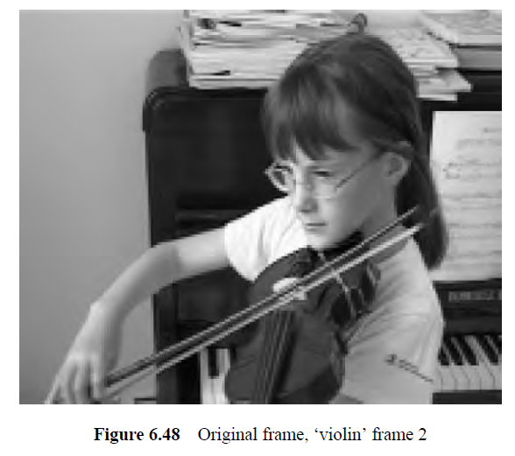
Loop filter - example
H.264 | MPEG-4 AVC - new key features

Slide 15
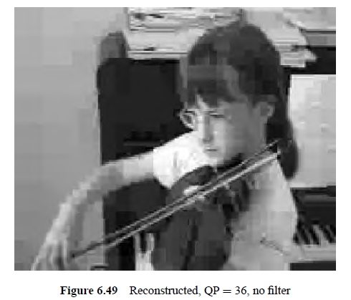
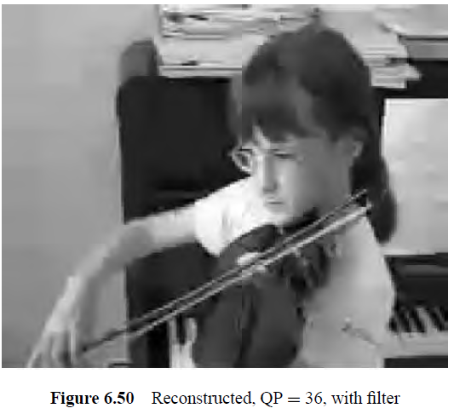
Loop filter - example
H.264 | MPEG-4 AVC - new key features

Slide 16
Entropy coding
H.264 | MPEG-4 AVC - new key features
Context-adaptive binary arithmeticcoding (CABAC) a method of arithmetic coding in which the probability models are updated based on previous coding statistics.
A common simple and highly structured variable length coding (VLC) technique for many of the syntax elements not coded by CABAC or CAVLC. A symbol is converted into a binary code with a specified length (n bits).

Slide 17
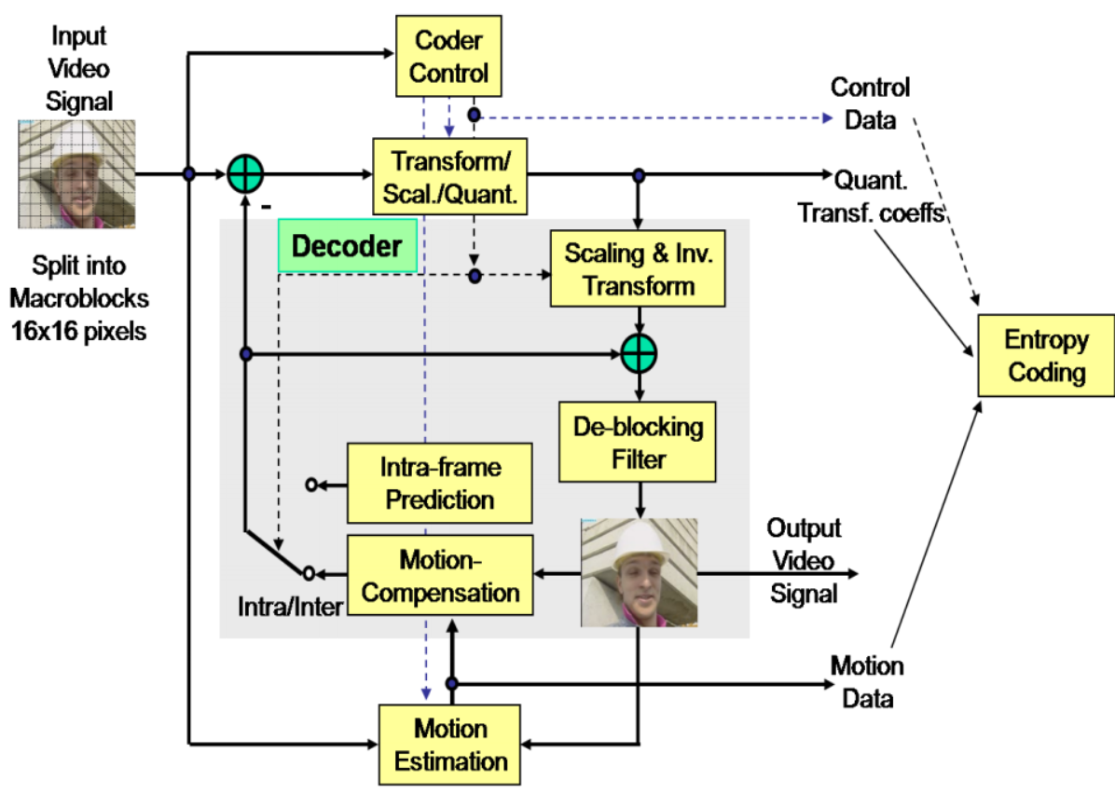
Block schema
H.264 | MPEG-4 AVC - new key features
Next frame - inter
First frame - intra
Reference frame
Intra frame
Inter frame
e(x,y,t)
I(x,y,t)
I(x,y,t)
I(x,y,t)
I(x,y,t)
I(x+u,y+v,t-1)
We have a reconstructed frame which could be a reference for a the next one.
I(x,y,t-1)
I(x,y,t-1)
mv

Slide 18
Why it so important?
H.264 | MPEG-4 AVC
Has huge significance to the broadcast, internet, consumer electronics, mobile and security industries, amongst others standards.
It describes and defines a method of coding video that can give better performance than any of the preceding standards(without H.265)
H.264 makes it possible to compress video into a smaller space, which means that a compressed video clip takes up less transmission bandwidth and/or less storage space compared to older codecs

Slide 19
1.2
HEVC
High Efficiency Video Coding

Slide 20
Introduction
H.265 | HEVC
Video compression format, a successor to H.264/MPEG-4 AVC
Jointly developed by the ISO/IEC Moving Picture Experts Group (MPEG) and ITU-T Video Coding Experts Group (VCEG)
Known as MPEG-H Part 2 and I H.265
February 2012 - complete draft of standard
On November 25 2013 - the HEVC standard was formally published by the ISO/IEC.

Slide 21
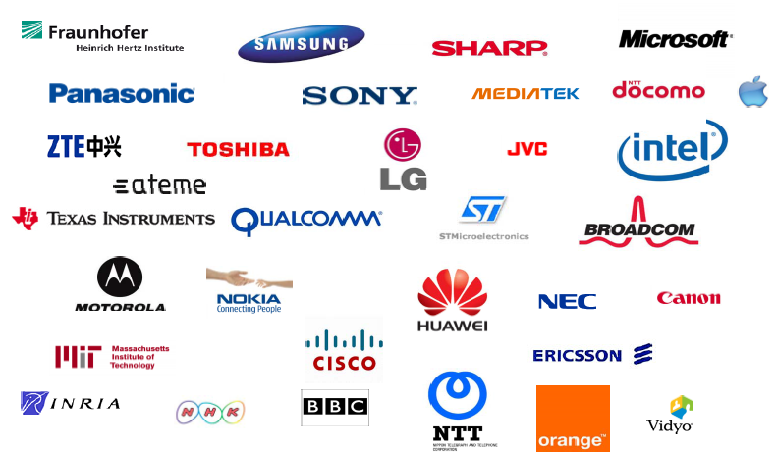
Standardization status
H.265 | HEVC
Strong industrial and academic interests
http://www.worldbroadcastingunions.org/wbuarea/library/docs/isog/presentations/2012B/2.4%20Vieron%20ATEME.pdf

Slide 22
General assumptions
H.265 | HEVC
“The main goal of the HEVC standardization effort is to enable significantly improved compression performance relative to existing standards—in the range of 50% bit-rate reduction for equal perceptual video quality. “
Moreover HEVC has been designed to address essentially all existing applications of H.264/MPEG-4 AVC and to particularly focus on two key issues:
  increased video resolution
  Increased use of parallel processing architectures.

Slide 23
Potential applications
H.265 | HEVC
What becomes possible with 50% video rate reduction?
Existing applications and usage scenarios
  IPTV over DSL : Large shift in IPTV eligibility
  Facilitated deployment of OTT and multi-screen services
  More customers on the same infrastructure: most IP traffic is video
  More archiving facilities
Future services
  1080p60/50 with bitrates comparable to 1080i
  Immersive viewing experience: Ultra-HD (4K, 8K)
  Premium services (sports, live music, live events,…): home theater, mobile
  HD 3DTV Full frame per view at today’s HD delivery rates

Slide 24
How to achieve the assumptions?
H.265 | HEVC
The design of most video coding standards and also of HEVC is primarily aimed at having the highest coding efficiency.
Coding efficiency is the ability to encode video at the lowest possible bit rate while maintaining a certain level of video quality

Slide 25
Coding structure
H.265 | HEVC
HEVC replaces macroblocks, which were used with previous standards, with Coding Tree Units (CTUs) and coding tree block (CTB) structure
CTU increases coding efficiency.
HEVC initially divides the picture into 3 CTB:
  1 luma CTB
  2 chroma CTB
The size L×L of a luma CTB can be chosen as L = 16, 32, or 64 samples, with the larger sizes typically enabling better compression
Supports partitioning of the CTBs into smaller blocks

Slide 26
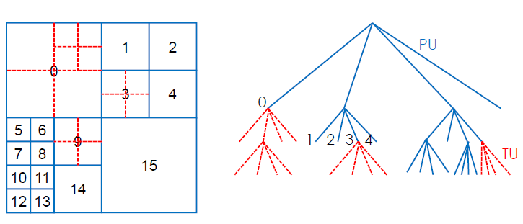
Coding structure
H.265 | HEVC
Quadtree
CUs are the basic unit of prediction in HEVC.
CUs can be 64x64, 32x32, 16x16 or 8x8.

Slide 27
Prediction
H.265 | HEVC
The decision whether to code a picture area using interpicture or intrapicture prediction is made at the CU level.
CUs can then be further split in size into prediction blocks (PBs).
HEVC supports variable PB sizes from 64×64down to 4×4 samples.

Slide 28
Prediction
H.265 | HEVC
Modes for splitting a CB into PBs, subject to certain size constraints. For intrapicture-predicted CBs, only M × M and M/2×M/2 are supported.

Slide 29
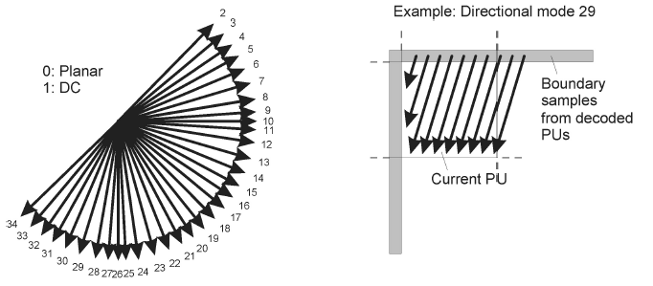
Intra predicting
H.265 | HEVC
Supports 33 directional modes + Planar (surface fitting) + DC (flat) prediction modes
The selected intra picture prediction modes are encoded by deriving most probable modes (e.g., prediction directions) based on those of previously decoded neighboring PBs.

Slide 30
Transform design
H.265 | HEVC
Transform Unit (TU)
  • DCT (Discrete Cosine Tranform)
  • Various sizes from 4x4 to 32x32
  • To adapt the transform to the signal frequency characteristics
  • TU can overlap PU
Intra
  DCT+ DST (Discrete Sine Transform) on Luma intra 4x4
    1% bit rate reduction
Inter
  - DCT only

Slide 31
Quantisation design
H.265 | HEVC
Quantisation – as in H.264, but with scaling matrices supported for the various transform block sizes.

Slide 32
Motion Vectors
H.265 | HEVC
Uses signed 16-bit range for both horizontal and vertical motion vectors (MVs)
2 modes of motion vector prediction :
  Advanced motion vector prediction (AMVP) - uses data from the reference picture and can also use data from neighboring prediction blocks
  A merge mode - allowing the inheritance of MVs from temporally or spatially neighboring PBs.

Slide 33
Motion compensation
H.265 | HEVC
Multiple reference pictures are used
For each PB, either one or two motion vectors can be transmitted, resulting either in unipredictive or bipredictive coding.
Interpolation of fractional luma sample positions
  It uses separable application of one-dimensional half-sample interpolation with an 8-tap filter or quarter-sample interpolation with a 7-tap

Slide 34
Entropy coding
H.265 | HEVC
Context adaptive binary arithmetic coding (CABAC) is used for entropy coding
Improve throughput speed by parallel-processing architectures and compression performance

Slide 35
What’s more
H.265 | HEVC
Deblocking filter similar to the one used in H.264/MPEG-4 AVC
Sample adaptive offset (SAO):
  Its goal is to better reconstruct the original signal amplitudes, to increase picture quality, reduce banding artifacts, and reduce ringing artifacts by using a look-up table.

Slide 36
2
Comparison
H.264 vs H.265

Slide 37
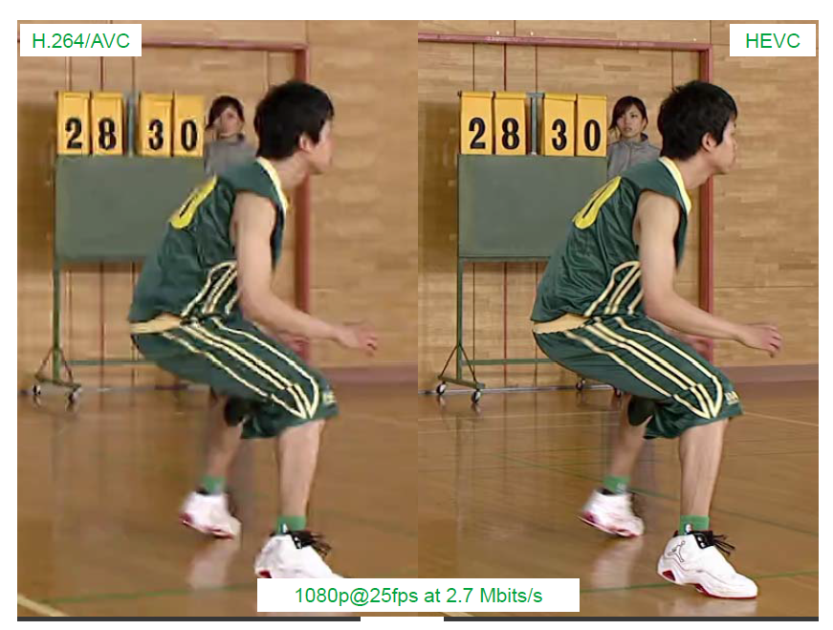
For what it all?
H.264 | MPEG-4 AVC VS H.265 | HEVC
http://www.worldbroadcastingunions.org/wbuarea/library/docs/isog/presentations/2012B/2.4%20Vieron%20ATEME.pdf

Slide 38
Main differences
H.264 | MPEG-4 AVC VS H.265 | HEVC
 | H.264/AVC | HEVC
Partition size | Macroblock 16x16 | (Large) Coding Unit 8x8 to 64x64
Partitioning | Sub-block down to 4x4 | Prediction Unit Quadtree down to 4x4 Square, symmetric and asymmetric (only square for intra)
Transform | Integer DCT 8x8, 4x4 | Transform Unit square IDCT from 32x32 to 4x4 + DST Luma Intra 4x4
Intra prediction | Up to 9 predictors | 35 predictors

Slide 39
Main differences
H.264 | MPEG-4 AVC VS H.265 | HEVC
 | H.264/AVC | HEVC
Motion prediction | Spatial Median (3 blocks) | Advanced Motion Neighbor (3 blocks) Vector Prediction AMVP (spatial + temporal)
Motion-copy mode | Direct mode | Merge mode
Motion precision | ½ Pixel 6-tap, ¼ Pixel bi-linear | ¼ Pixel 7or 8 tap 1/8 Pixel 4-tap chroma
Entropy coding | CABAC, CAVLC | CABAC
Filters | Deblocking Filter | Deblocking Filter Sample Adaptive Offset

Slide 40
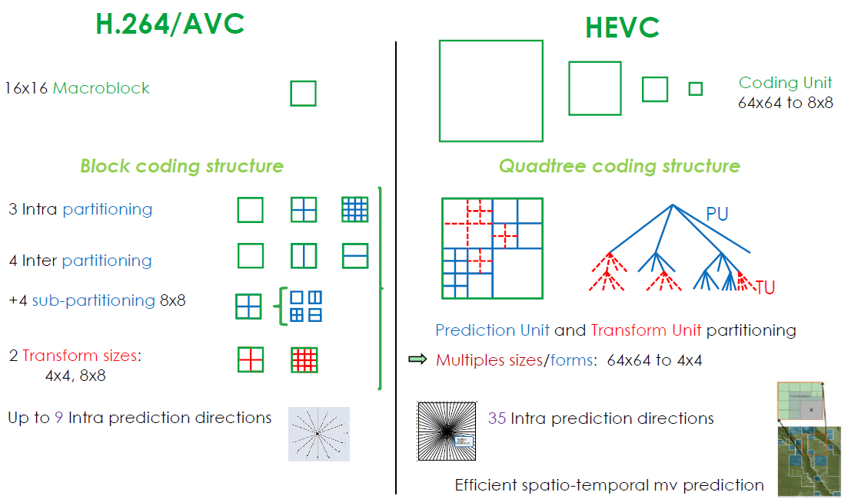
H.264 | MPEG-4 AVC VS H.265 | HEVC
http://www.worldbroadcastingunions.org/wbuarea/library/docs/isog/presentations/2012B/2.4%20Vieron%20ATEME.pdf

Slide 41
3
Simulation data

Slide 42

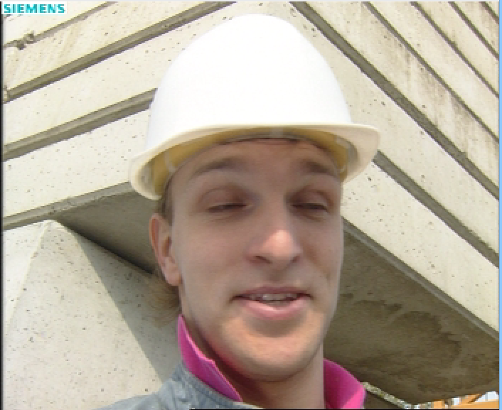
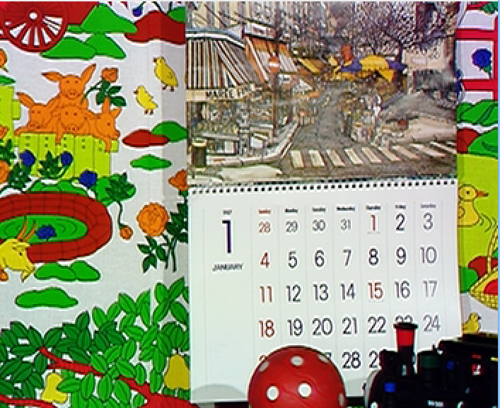
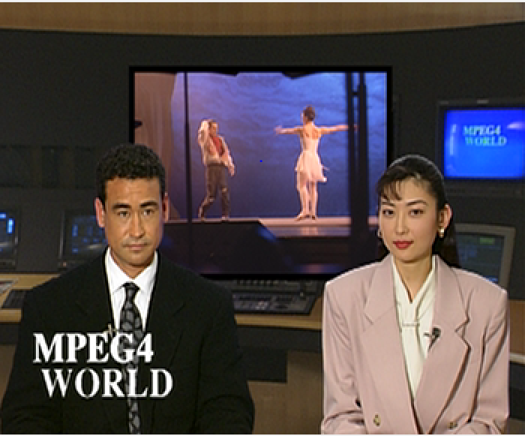
Introduction to sequences
– SIMULATION DATA
Coastguard
lots of movement, normal spatial redundancy
Foreman
high spatial redundancy, low movement
Mobile
low redundancy, lot of movement
News
low movement, high redundancy

Slide 43
All sequences – H.264
H.264 | MPEG-4 AVC – SIMULATION DATA
The best compression ratio to quality has sequence news, because of it's low movement and high redundancy. The worse is mobile, because of it's high movement, movement of object and the background.

Slide 44
All sequences – H.264
H.264 | MPEG-4 AVC – SIMULATION DATA
For the same reasons as we told before to encode news sequence we don't need a lot of bit rate, because following frames are really similar to each other.

Slide 45
Search range gain - foreman
H.264 | MPEG-4 AVC – SIMULATION DATA
We checked all sequences for changing Search rage and we didn't see any high gain in quality, it's probably, because in our sequences there is no high speed moving object so search range of 32 it's enough to notice all movement.

Slide 46
Search range gain - coastguard
H.264 | MPEG-4 AVC – SIMULATION DATA
The same goes for coastguard and all other sequences.

Slide 47
All sequences - HEVC
HEVC– SIMULATION DATA
The same as in h.264 encoder we also get the best compression to quality for sequence with the highest redundancy and lowest movement.

Slide 48
All sequences – HEVC
HEVC– SIMULATION DATA
Here we can see that differences in times are much bigger than in h.264. HEVC is very complicated encoder and we didn’t notice any correlation between redundancy of the sequences and the times.

Slide 49
Intra period gain - foreman
HEVC– SIMULATION DATA
Adding more reference Intra frames is lowering drastically our quality for the same bit rate, because Intra frames provide lower compression than for example B frames and our encoder needs to use higher quantization factors. It's lowering our transmission's resistance for channel errors, but in this simulation were done with use of no error channel.

Slide 50
Intra period gain - coastguard
HEVC– SIMULATION DATA
We can see that this gain is huge it's about 5 dB, and that's is a lot.

Slide 51
Group of pictures - foreman
HEVC– SIMULATION DATA
Use of GOP structure of only B frames give us some gain in quality. It's thanks to that because B frames gives us better compression options, but it's lowering resistance for channel errors. In real transmission it would be better to use GOP structure with PBBB, because it will give us more resistance for channel errors, for not so much cost in bit rate.

Slide 52
Group of pictures - mobile
HEVC– SIMULATION DATA

Slide 53
Group of pictures - news
HEVC– SIMULATION DATA

Slide 54
Group of pictures - coastguard
HEVC– SIMULATION DATA

Slide 55
Search range gain - mobile
HEVC– SIMULATION DATA
We checked all sequences for changing Search range and we didn't see any high gain in quality, it's probably, because in our sequences there is no high speed moving object so search range of 32 it's enough to notice all movement.

Slide 56
Search range gain - mobile
HEVC– SIMULATION DATA
We get no noticeable gain in quality by changing Search range, but the times get dramatically higher, up to even 400 seconds ! It's only good idea to use it for some sequences in which we have we big movements of object between following frames.

Slide 57
SR full, FDM, FEN and FS – mobile
HEVC– SIMULATION DATA
From our practical tests, we concluded that fast search, fast encoder decision and Fast decision for Merge RD cost modules are very well implemented and it's not worth to turn them off.

Slide 58
SR full, FDM, FEN and FS
HEVC– SIMULATION DATA
Turning them off makes encoding times highly increase.

Slide 59
Decoding Refresh Type - mobile
HEVC– SIMULATION DATA
We didn't notice any significant gain, by changing Decoding Refresh Type.

Slide 60
Decoding Refresh Type - mobile
HEVC– SIMULATION DATA
The times also didn't show that there was any major change. We can only see that no random access needs slightly more time

Slide 61
H.264 vs HEVC – SIMULATION DATA COMPARISON
We can see that HEVC encoder is a lot more better than h.264 standard. There is about 2 dB difference. This means that it provide allmost 50% better quality than h.264. However the encoding times for HEVC are terrible in comparison to h.264. Sometimes h.264 is about two times quicker.

Slide 62
H.264 vs HEVC – SIMULATION DATA COMPARISON
Here we notice a bit lower gain, but the times difference gets really huge. We can see that sequences with lot of movement needs a lot computation from HEVC. It's probably, because of it's complexity and a lot calculation needs to be made, it has a lot more option to consider than h.264.

Slide 63
H.264 vs HEVC – SIMULATION DATA COMPARISON
In this sequences we can see that for low very bit rates HEVC and h.264 provides almost the same quality, but HEVC now is much quicker. Since 400kbit/s HEVC gains about 1,5-2dB of PSNR in comparison with H.264

Slide 64
H.264 vs HEVC – SIMULATION DATA COMPARISON
For this sequence HEVC has a lot more higher times than h.264, but it still provides better quality at least 1 dB better. For higher bitrates gain of PSNR is rising.

Slide 65
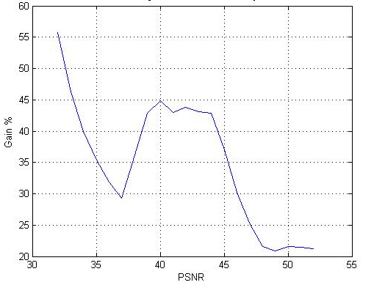
Bit-rate saving rate - foreman
H.264 vs HEVC – SIMULATION DATA COMPARISON
[db]
He we can see that HEVC for the same quality gives us much lower bit rates than h.264, even up to 56% lower !.

Slide 66
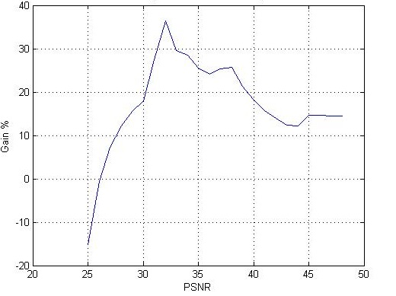
Bit-rate saving rate - mobile
H.264 vs HEVC – SIMULATION DATA COMPARISON
[db]

Slide 67
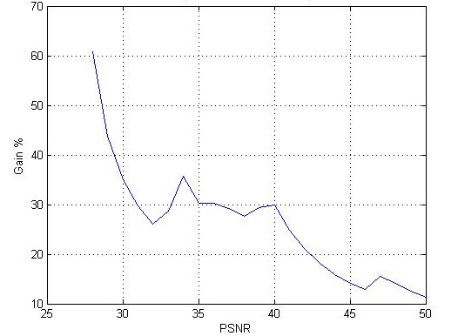
Bit-rate saving rate - news
H.264 vs HEVC – SIMULATION DATA COMPARISON
[db]

Slide 68
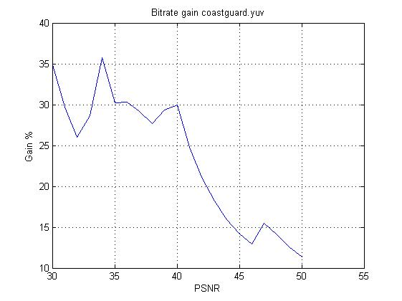
Bit-rate saving rate - costguard
H.264 vs HEVC – SIMULATION DATA COMPARISON
[db]
Almost all sequences HEVC gives us the highest gain. Here even 62 %.

Slide 69
4
Bibliography

Slide 70
Bibliography
http://en.wikipedia.org/wiki/H.264/MPEG-4_AVC
Lecture slides of subject Equipos Multimedia
  Tema 11: Estándar d e compresión de vídeo H.264
ITU-T Recommendations: H.264 : Advanced video coding for generic audiovisual services
http://www.itu.int/rec/T-REC-H.264-201201-S/en
“THE H.264 ADVANCED VIDEO COMPRESSION STANDARD” Iain Richardson [6.5.0-6.5.4];[7.4]
http://www.worldbroadcastingunions.org/wbuarea/library/docs/isog/presentations/2012B/2.4%20Vieron%20ATEME.pdf

Slide 71
Bibliography
“Overview of the High Efﬁciency Video Coding (HEVC) Standard” Gary J. Sullivan, Fellow, IEEE, Jens-Rainer Ohm, Member, IEEE, Woo-Jin Han, Member, IEEE, and Thomas Wiegand, Fellow, IEEE

Slide 72
thank you for your attention

